Slide 1
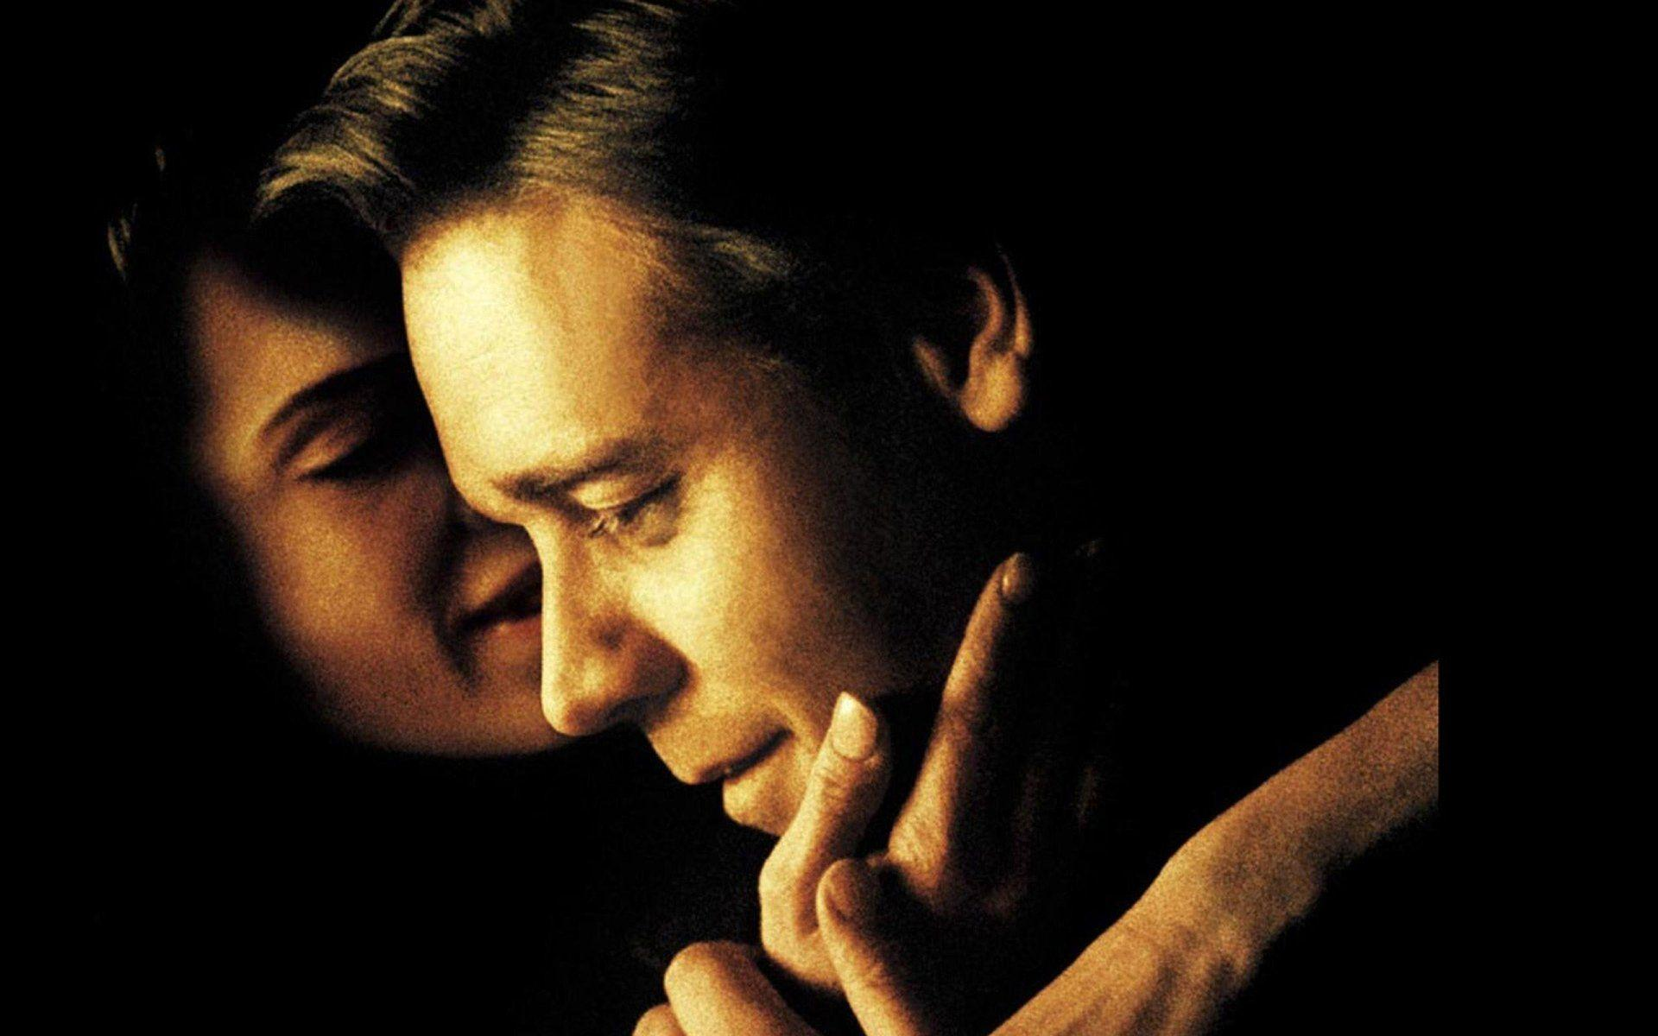
A Beautiful Mind
summary

Slide 2

01
Cause
The
Contents
02
Process
Result
03

Slide 3

01
Cause
The movie began in 1947 at Princeton, where John Nash had arrived as a graduate student.
聂相桐 22121603
阿克楚 22120097

Slide 4
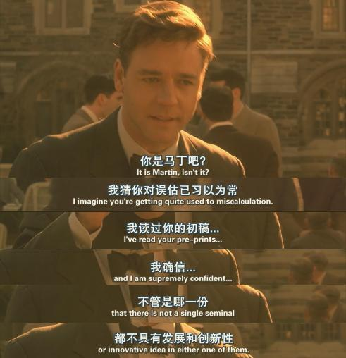

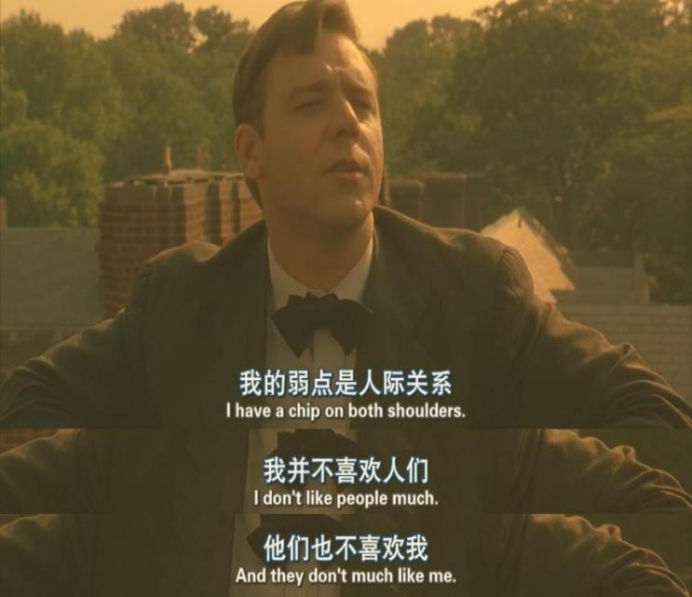
John was known for his brilliant mind, yet he was a bit stubborn. Moreover, he struggled with social interactions and found it difficult to fit into groups.
聂相桐 22121603

Slide 5
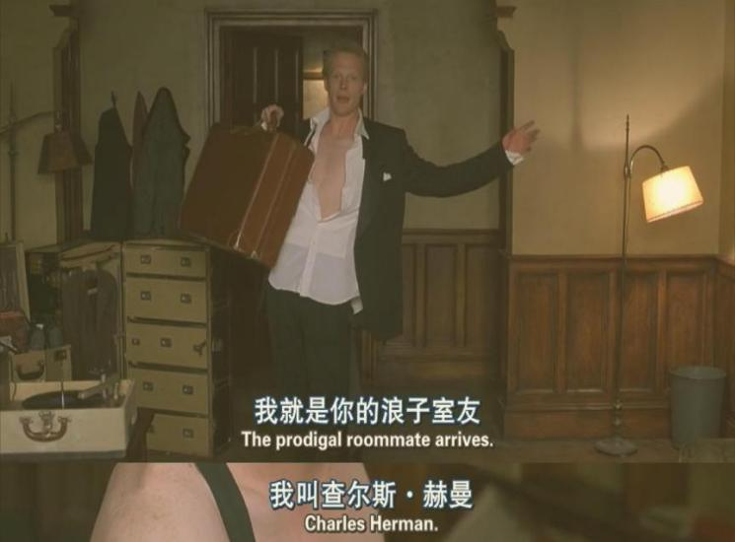
Charles
01
At Princeton, John met Charles Herman, who became John's best friend and provided him with a lot of companionship, but Charles was a figment of John's imagination.
聂相桐 22121603

Slide 6
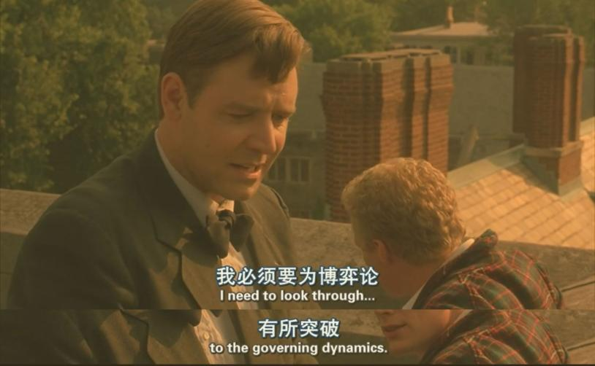
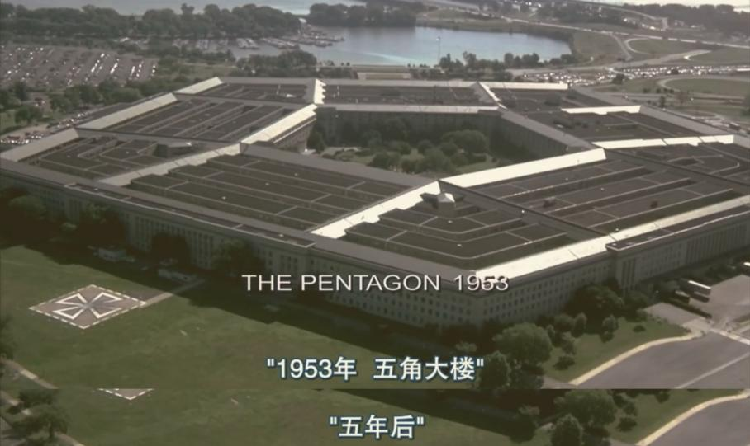
John was dedicated to researching his own original theories. Despite setbacks, he eventually made a groundbreaking discovery in mathematics,earning him a position at MIT and later,a job at Pentagon.
楚阿克 22120097

Slide 7
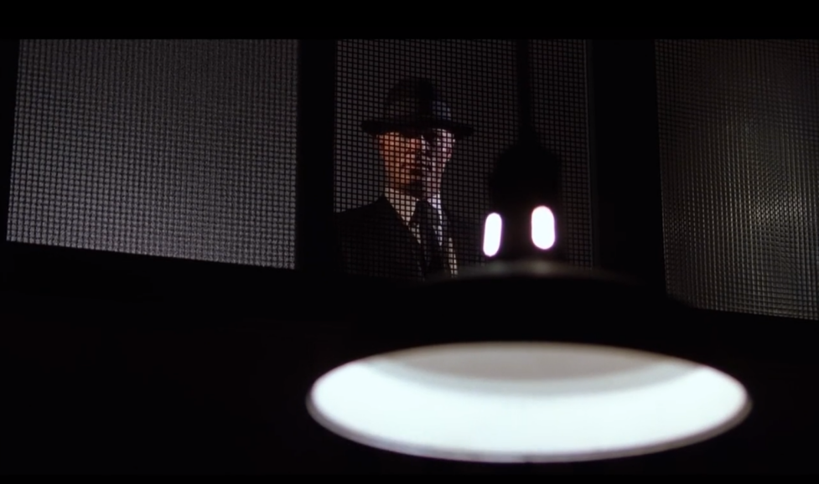
William Parcher
John was tired of the boring job of teaching.During a work trip, John demonstrated remarkable skill in breaking code.
And he first encountered the mysterious agent William Parcher, who was also a figment of John's imagination.
01
楚阿克 22120097

Slide 8
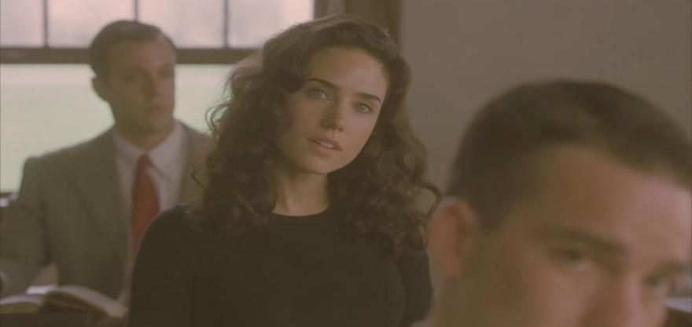
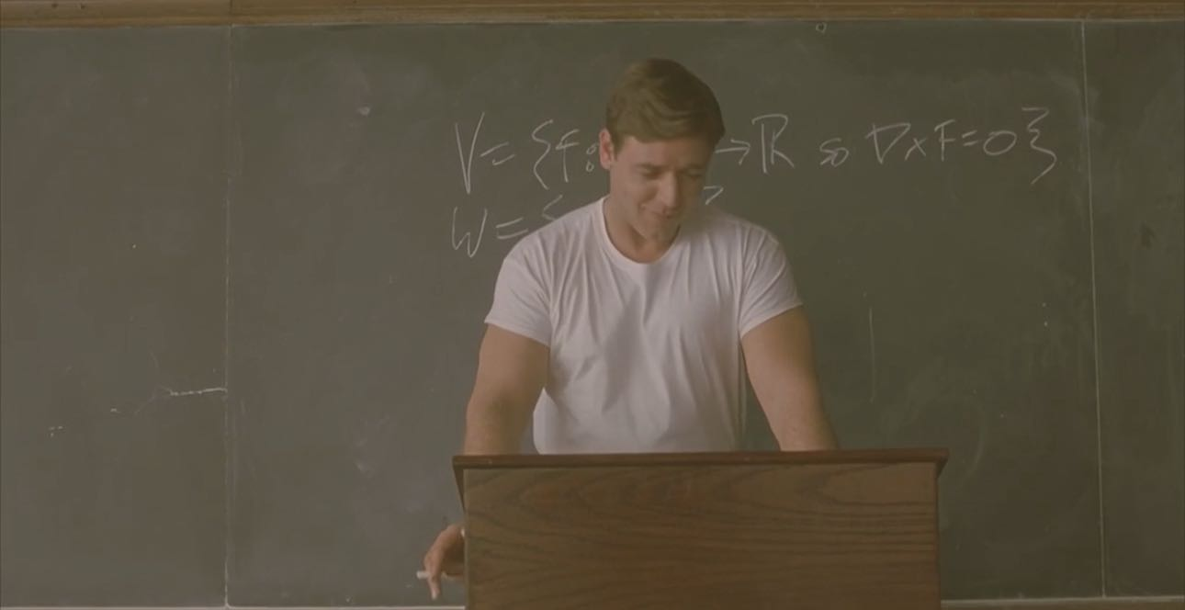
In one of his classes, John met a beautiful and intelligent girl, Alicia Larde.
Alicia Larde
楚阿克 22120097

Slide 9
02
Process
How did John work for William
张夏欣 23D30009
陈炳印 22124022

Slide 10
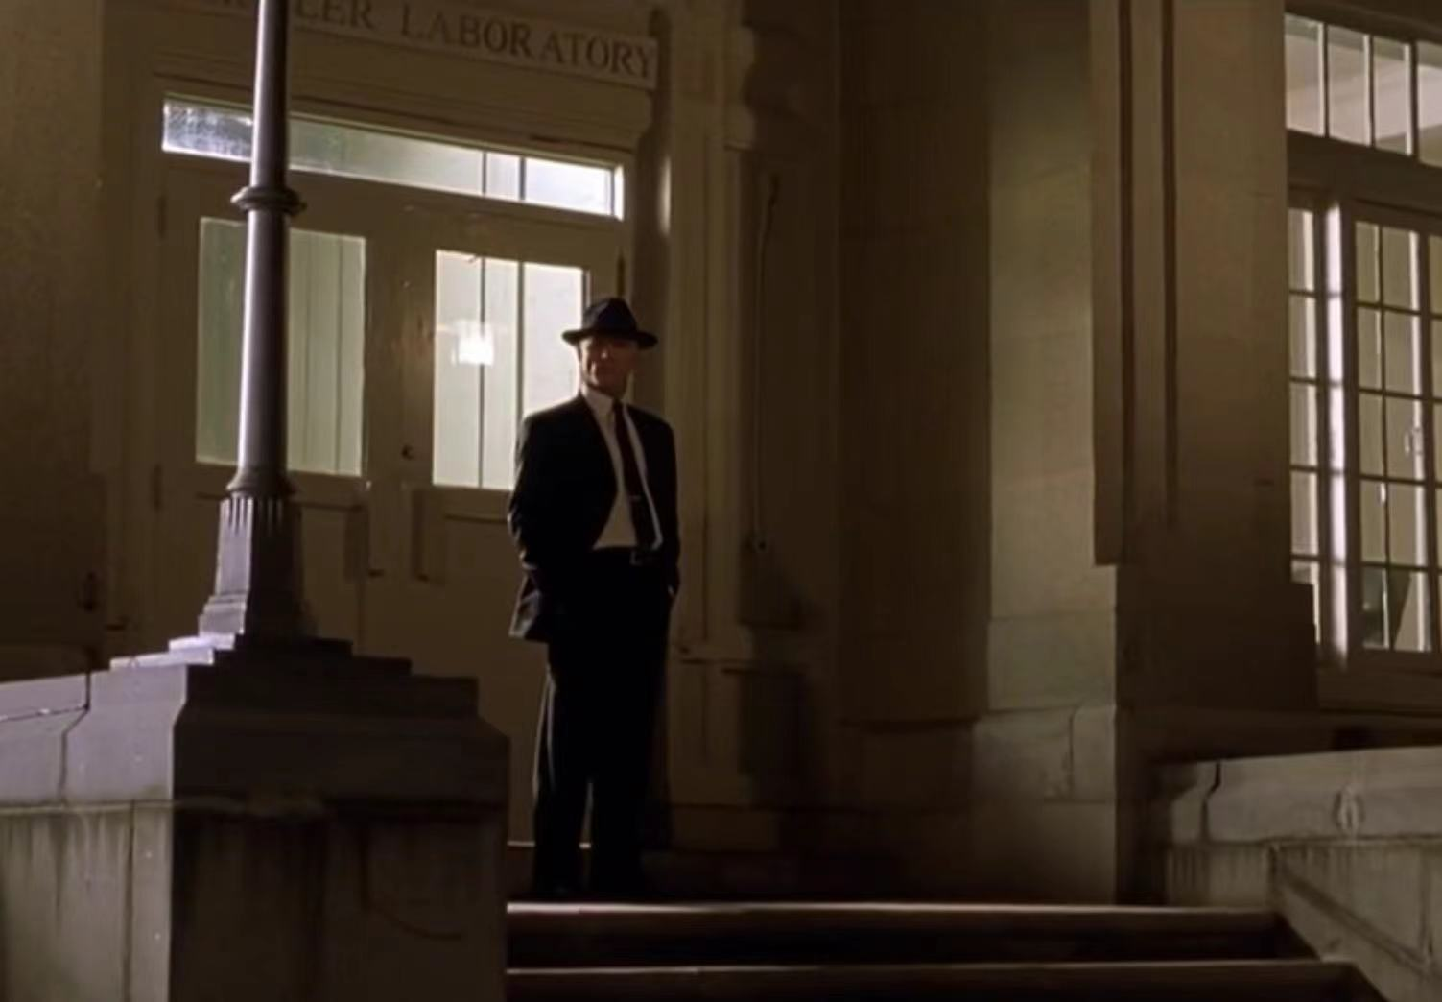
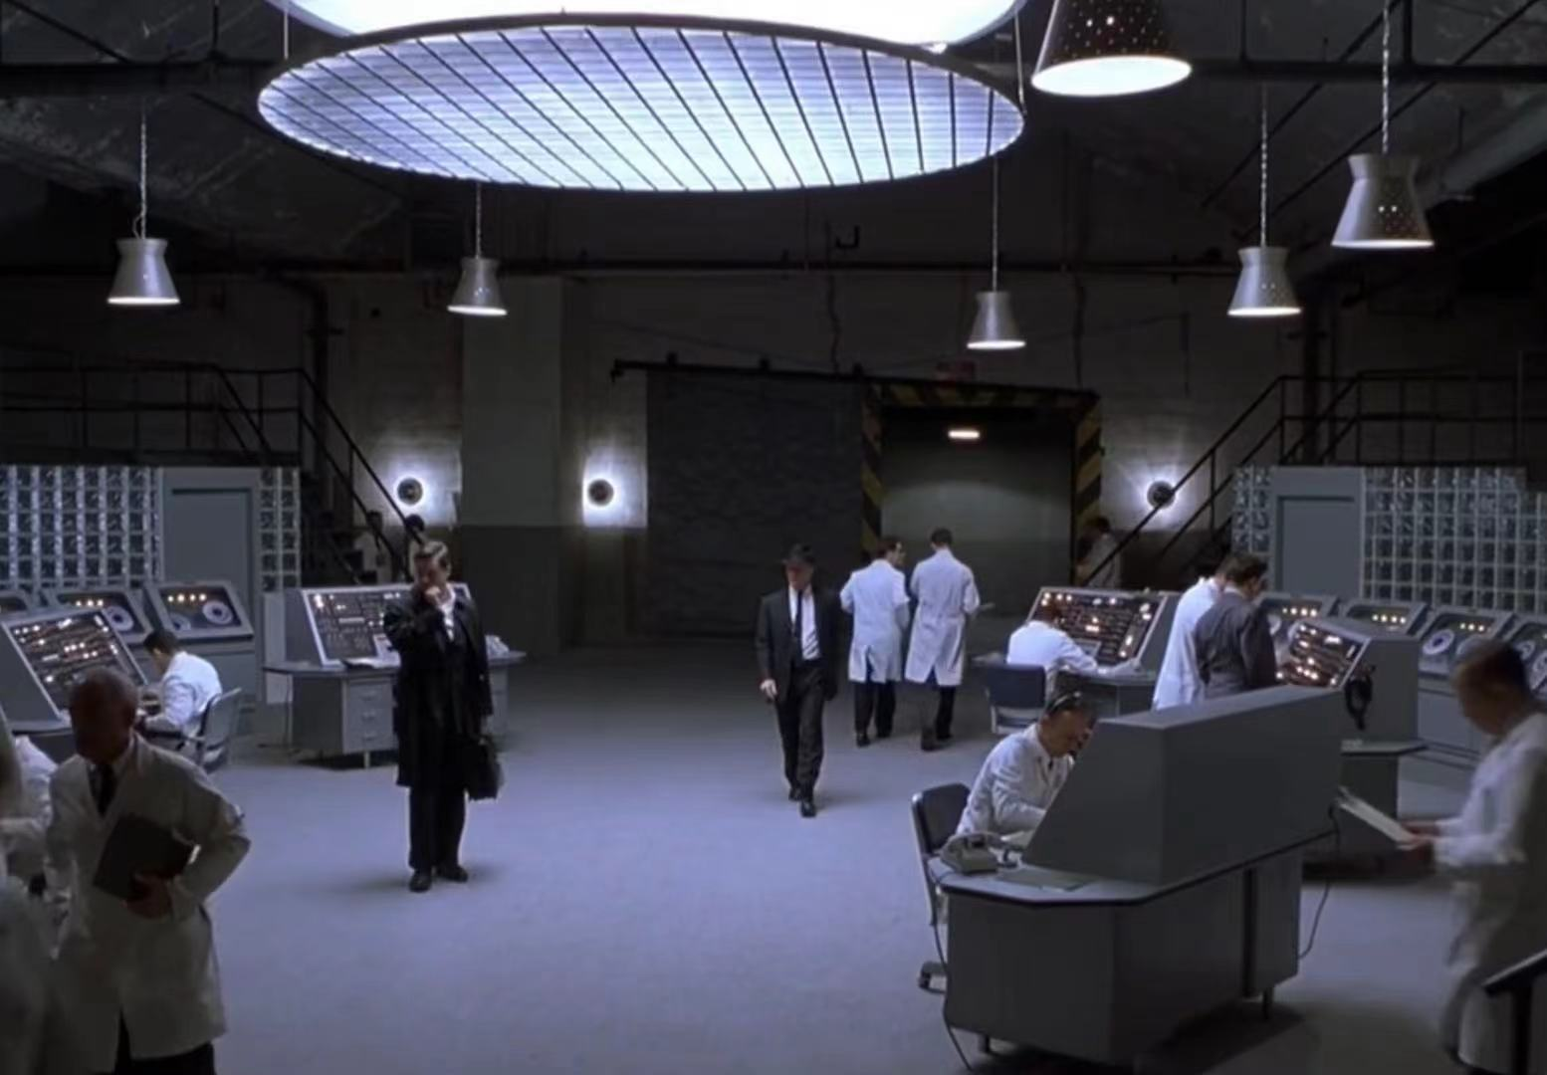
Contact with William
张夏欣
When Nash get off work from the Wheeler Lab building after work one night, William follows and observes him and initiates a conversation. He takes John to a heavily-jurisdictional factory and shows him the layout inside.
张夏欣 23D30009

Slide 11
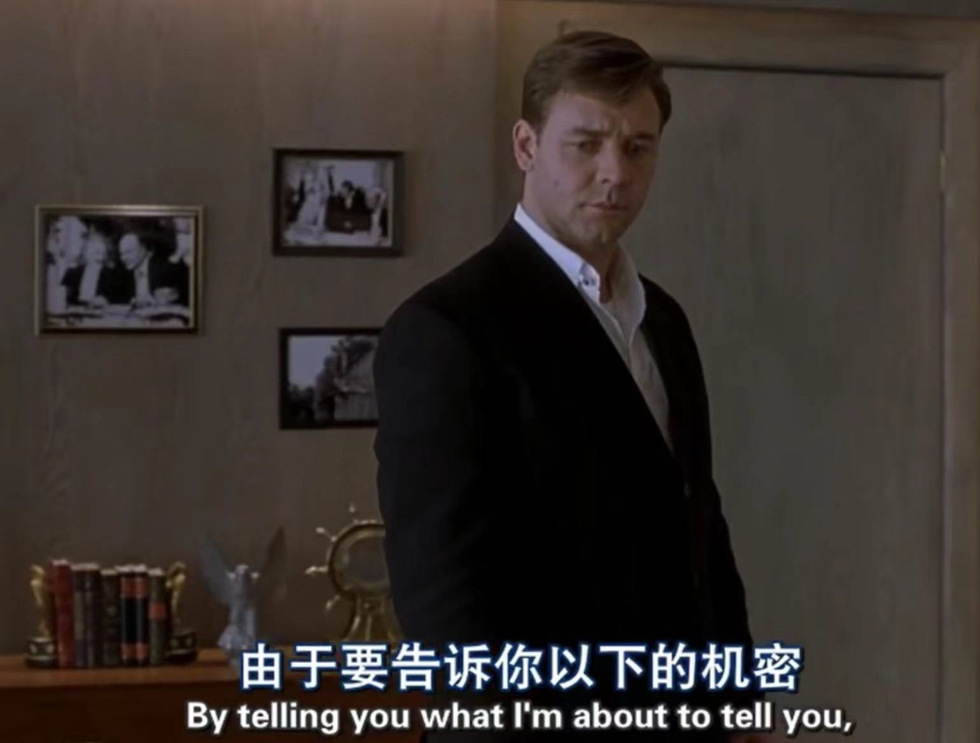
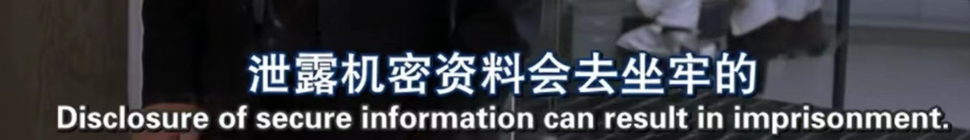
Undersanding the work
William told John about the top secret of the place that the Soviet action would cause a lot of casualties among the people, so they needed his help.
He praised John's talent highly and also threatened John not to reveal the secret or he would go to jail.
张夏欣 23D30009

Slide 12
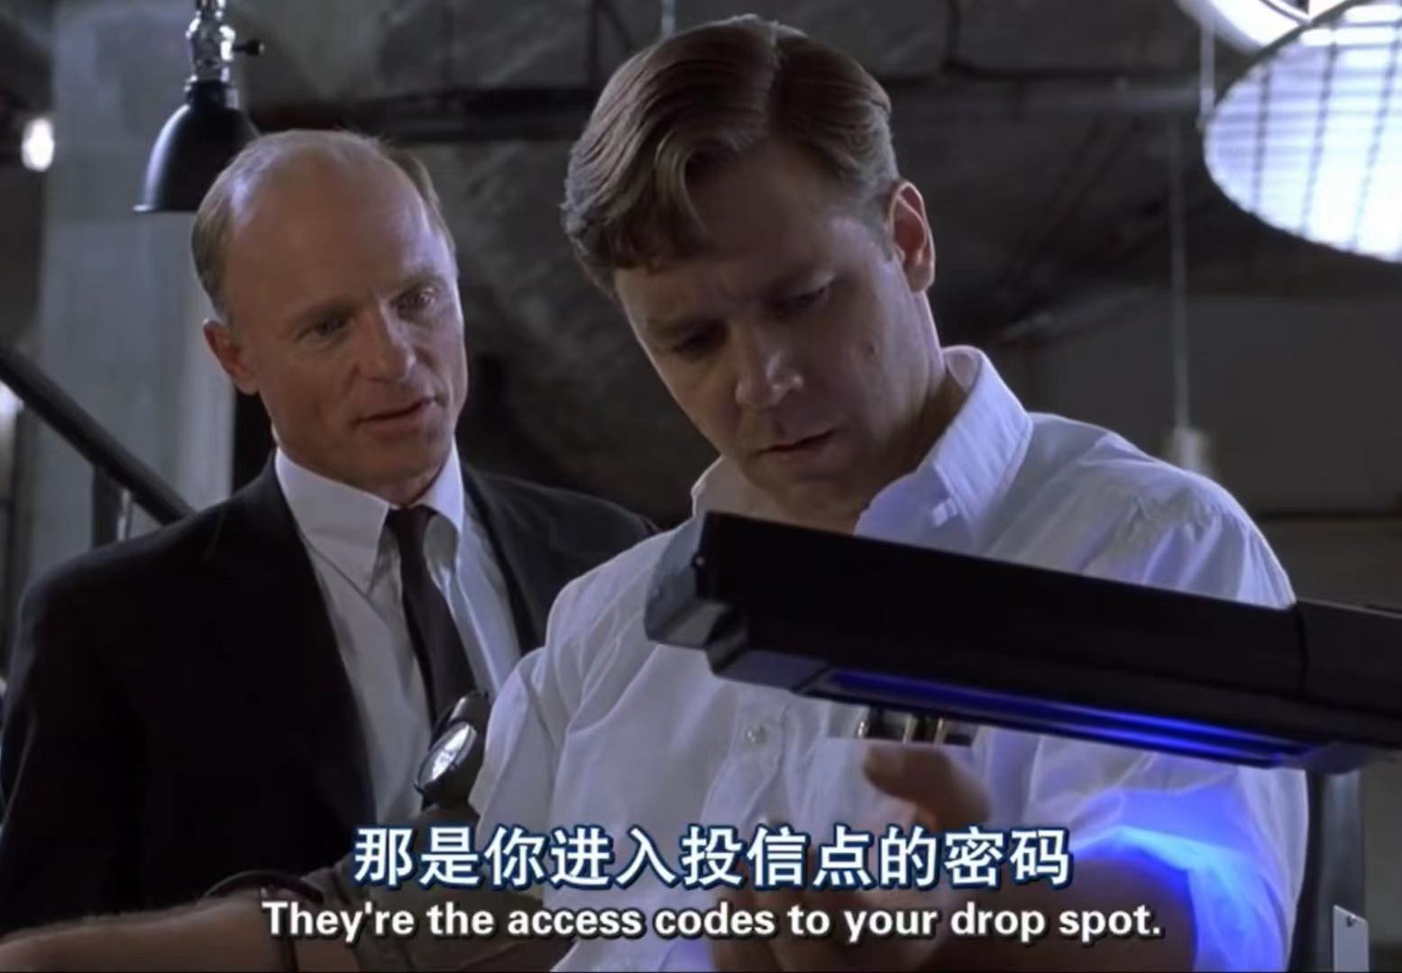
Accept the job
Praised and encouraged by William, John passively accepted the secret job. Then the staff examined him and installed the mark on his body that William had used as a code for the joint.
张夏欣 23D30009

Slide 13
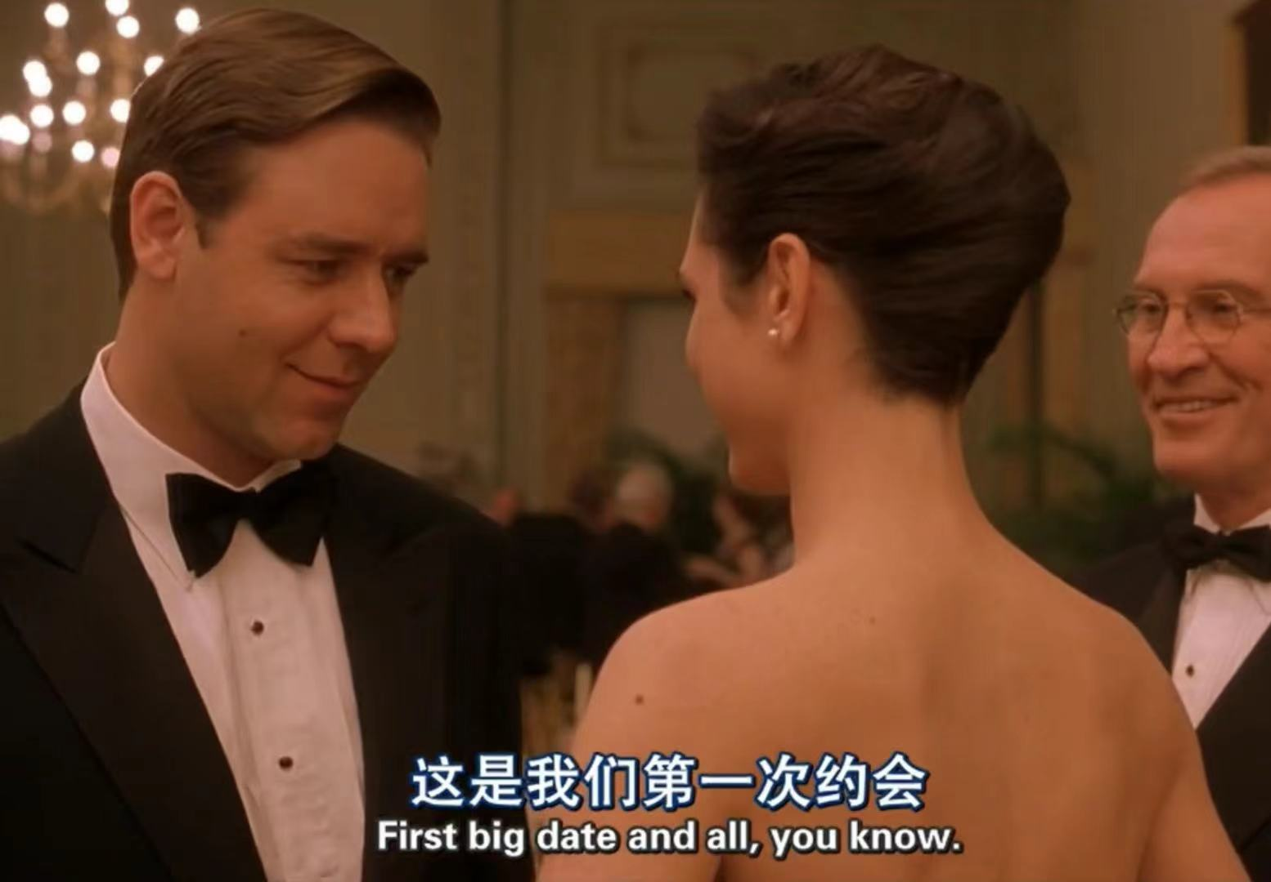
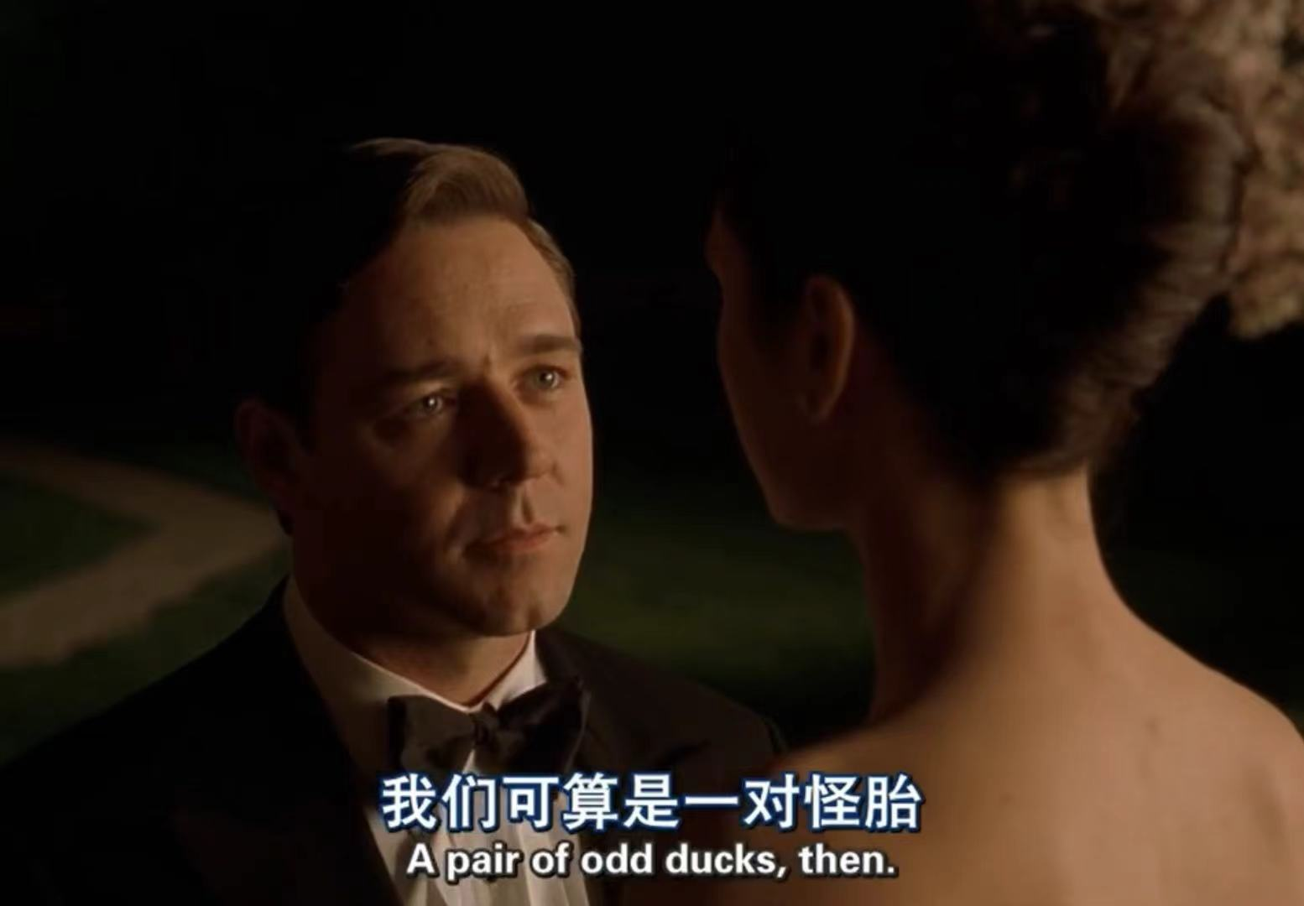
Date with Alicia
John began to work in his the office seriously, and Alicia came to see him, and they started dating. Alicia is tolerant of John's mannerisms, and John thought Alicia and him had common fecture that they were a good match.
张夏欣 23D30009

Slide 14
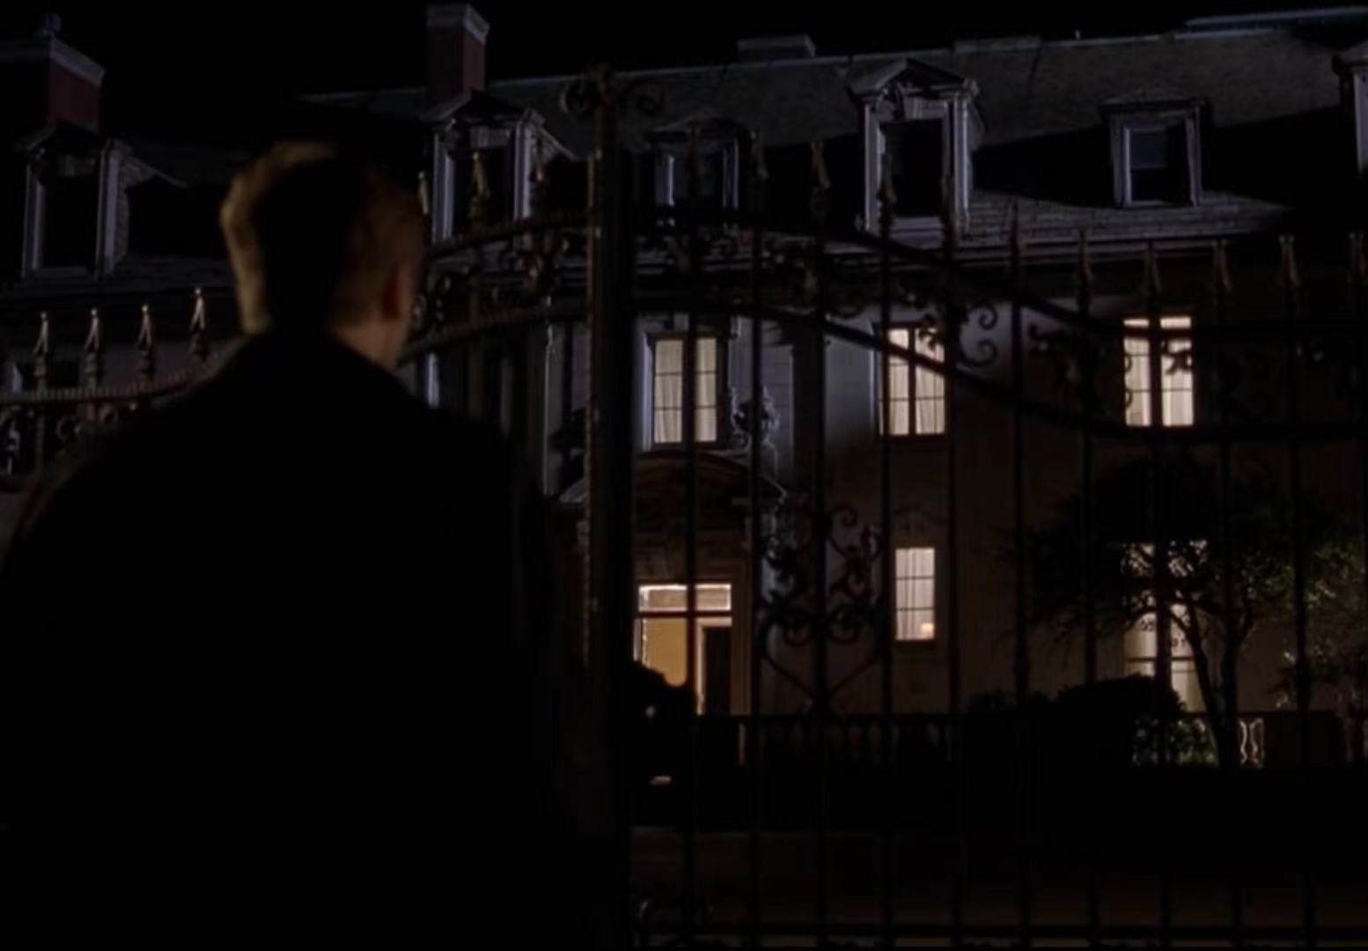
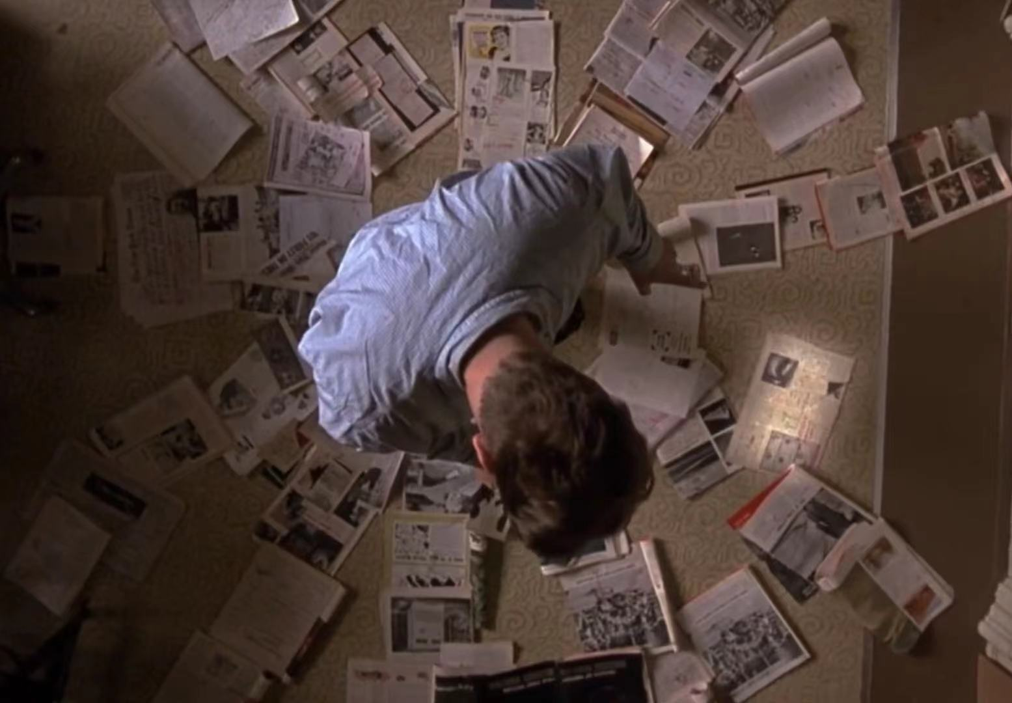
Transmiss classified document
John focused on deciphering potential codes, and by nightfall he arrived at a mysterious building and put his deciphered letters into a secret mailbox.
张夏欣 23D30009

Slide 15
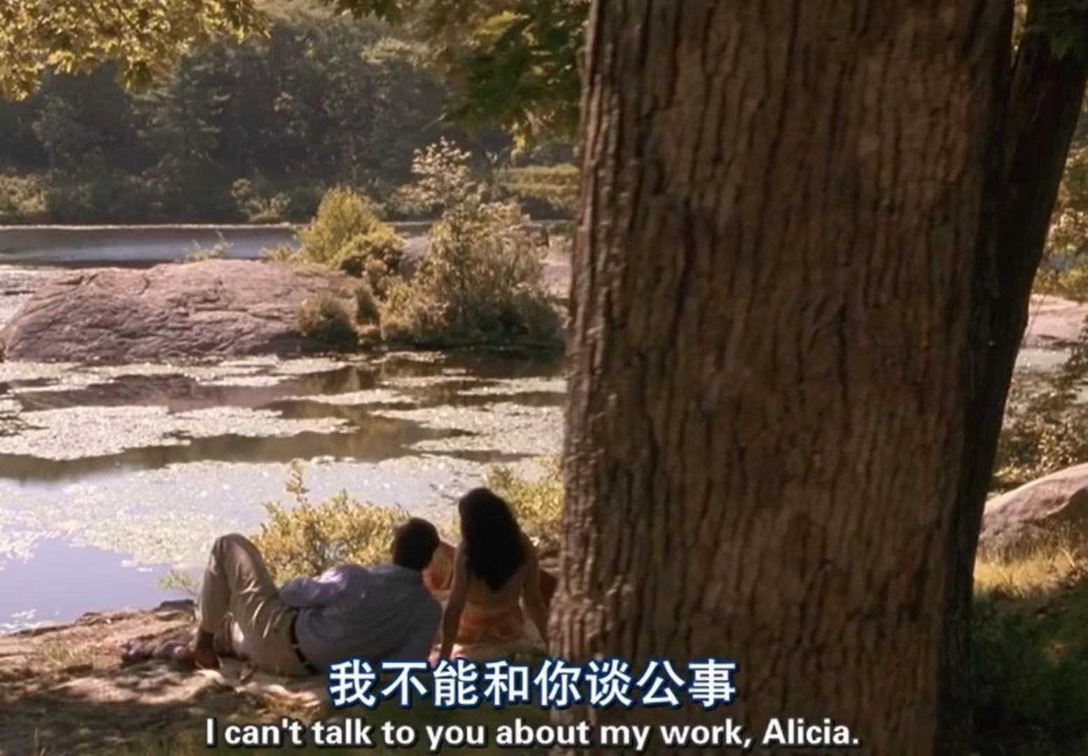
Fall in love with Alicia
John and Alicia's date went well, but John kept his work a secret and Alicia didn't ask questions.
张夏欣 23D30009

Slide 16
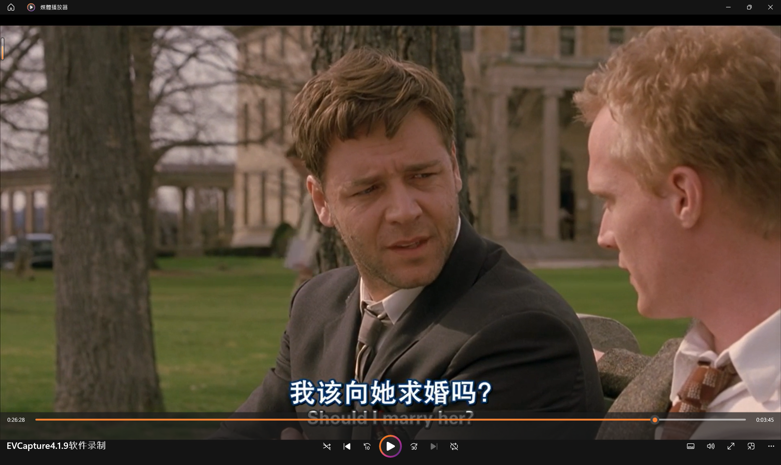
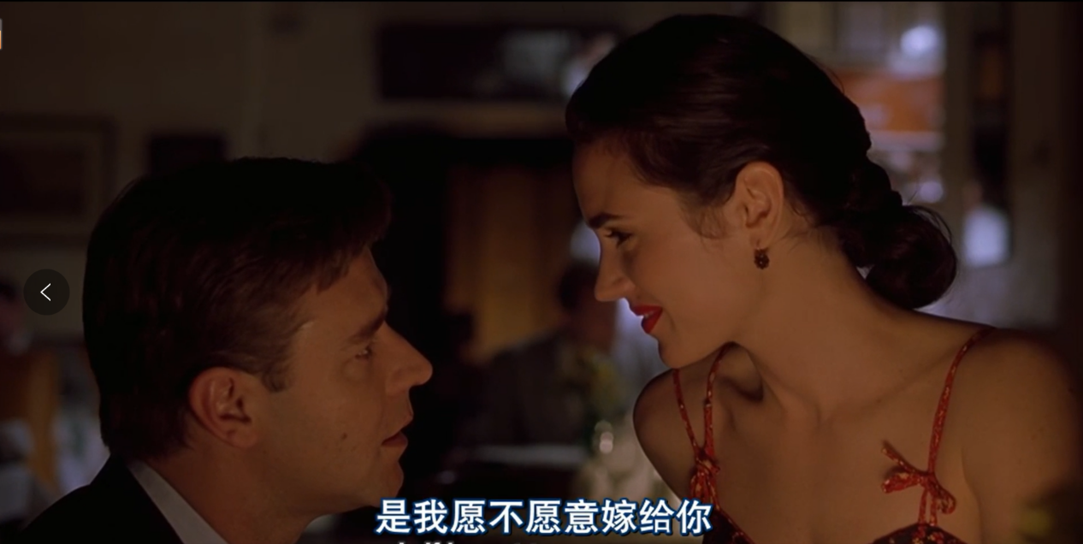
Get Married
In his imagination,Nash took courage to make a proposal to Alicia,.But beacause he was trapped in his work,he was late to date with his lover.Fortunately,he moved Alicia with his empressement,and finally got Alicia,’s agreement.
Enter your title
陈炳印 22124022

Slide 17
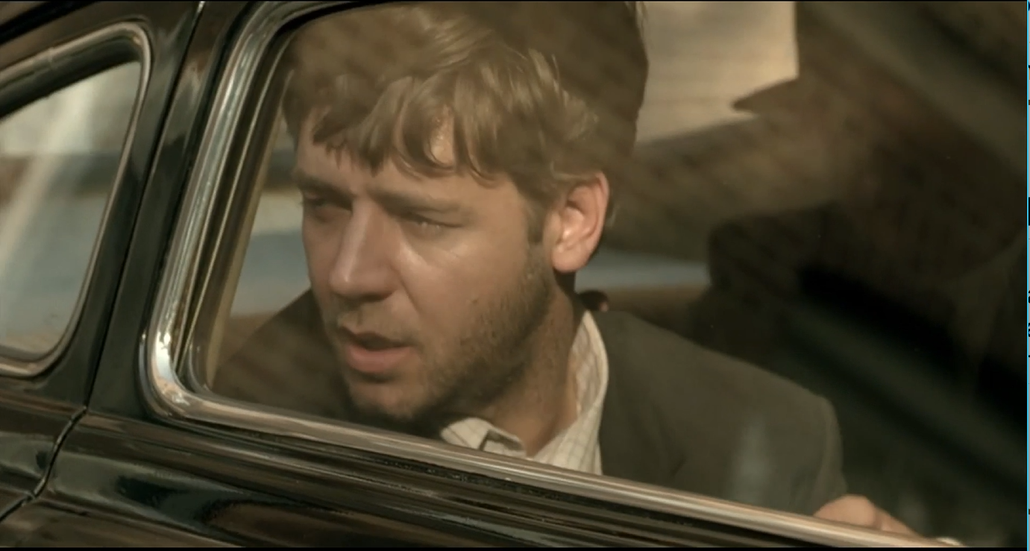

After Nash and Alicia,got married,Nash’schizophrenia got heavier and heavier.One night,Nash imagined that he was stricken by a group of Russian spies with guns after he passed information and was taken on board by Parcher.Since then,he treated his wife rudely and coldly.Under the big psychic pressure,he tried to refuse to sever for Parcher continuously in his mind，but failed
Get Crazier
Trapped in bedlam
One day,when Nash toke a speech on the Harvard University,he suddenly got mad,saw Parcher and ran away from the hall.but he was finally carried by Dr.Rosen and sent to bedlam.
陈炳印 22124022

Slide 18
03
Result
His wife thought he was sick and called a psychologist.
22121630 汪江豪
22122756 王子昊

Slide 19
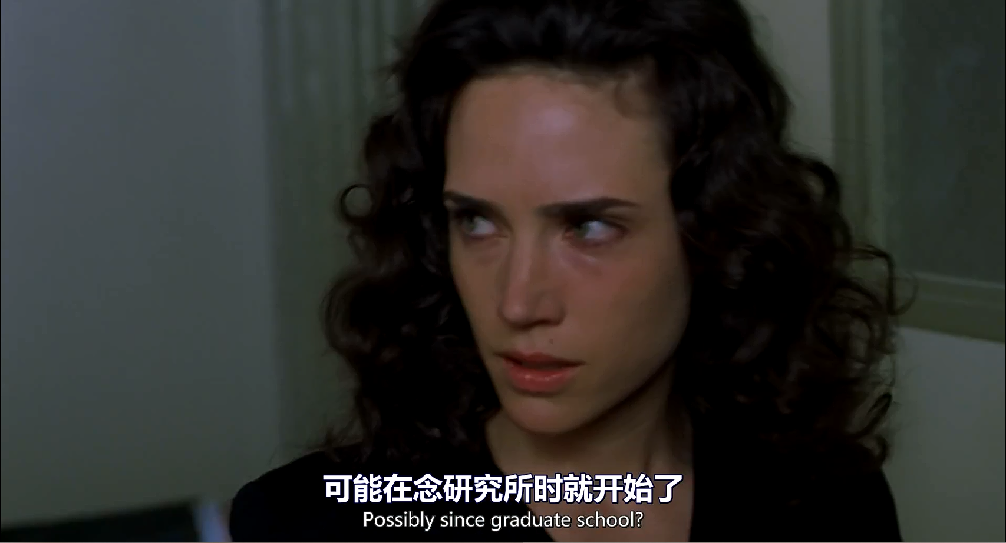
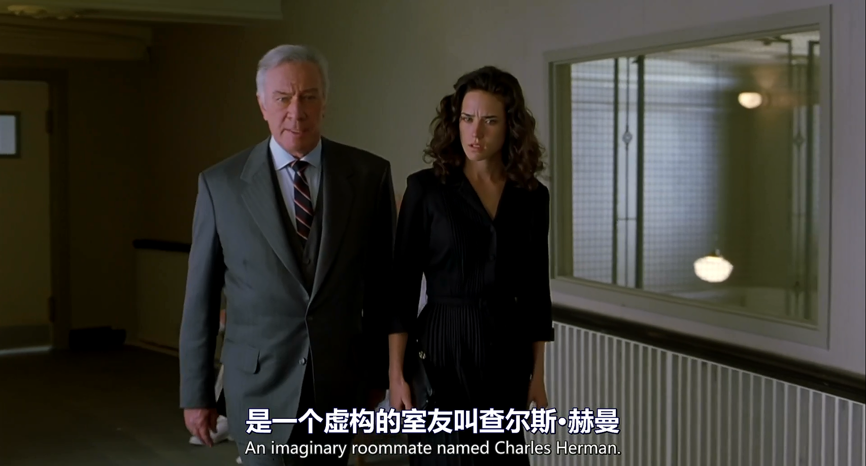
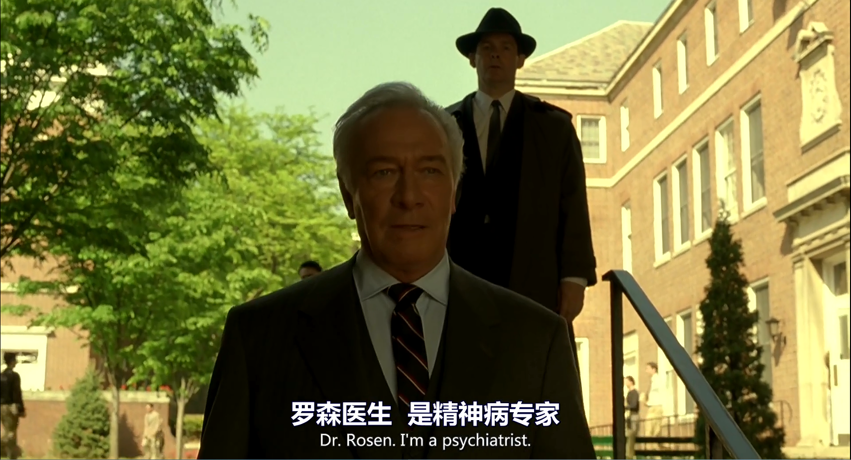
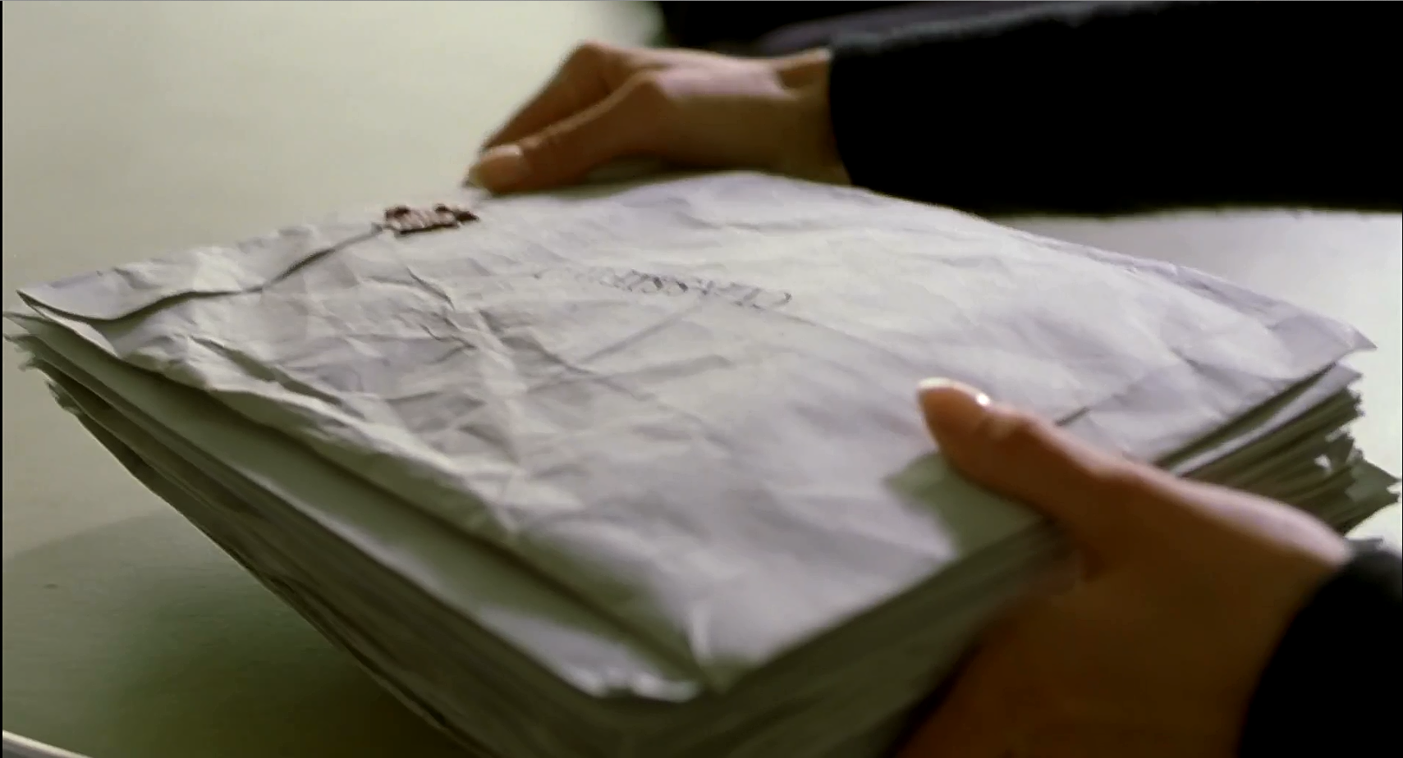
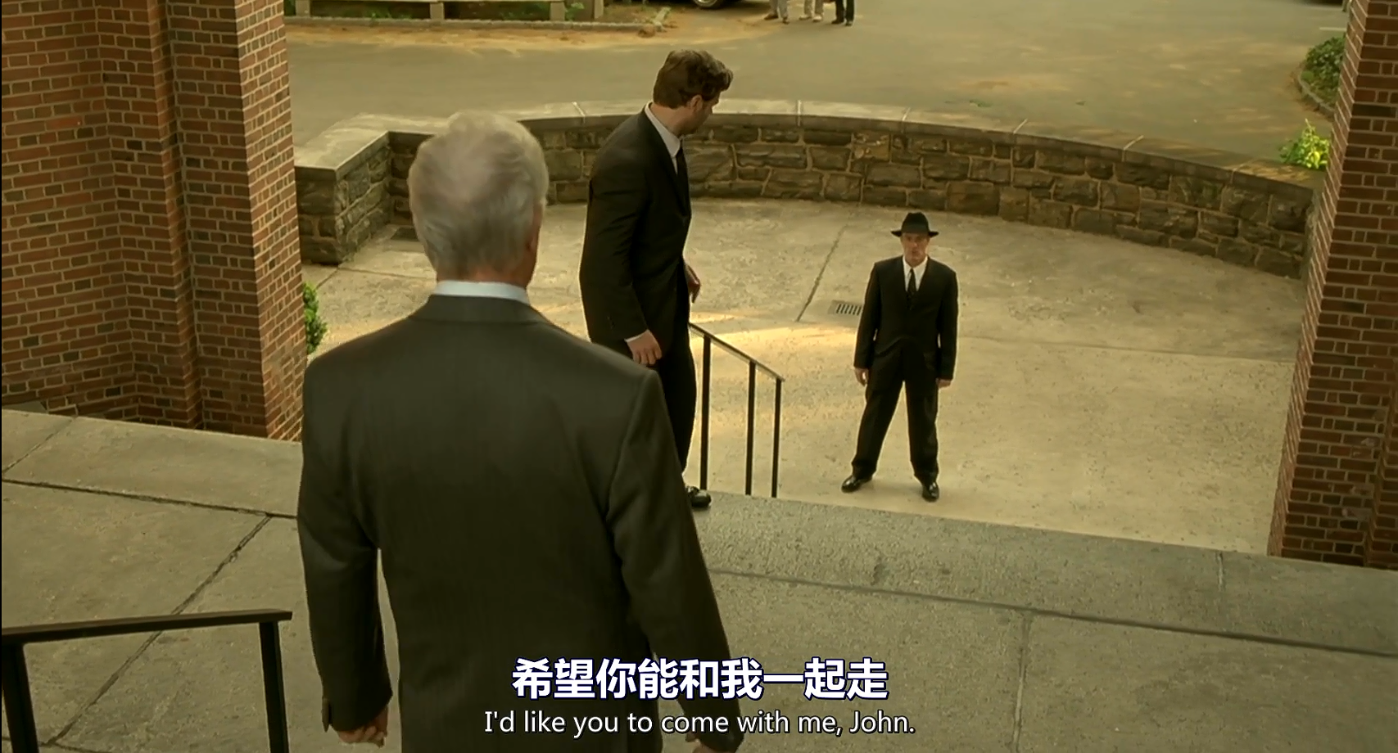
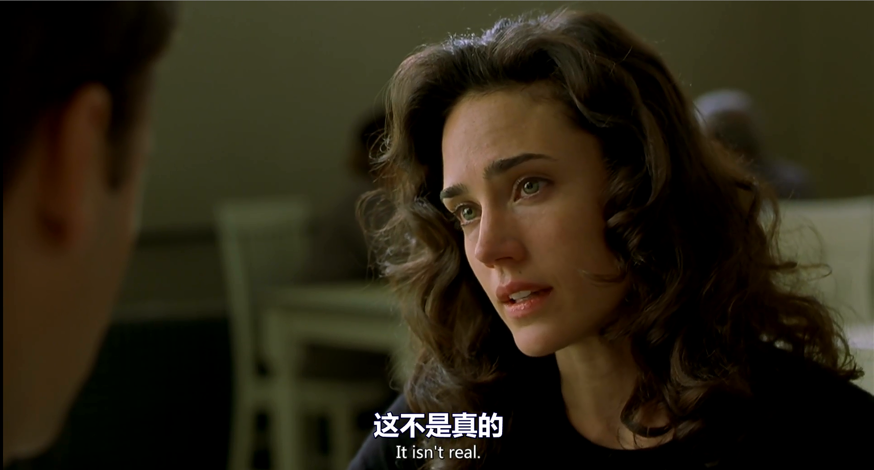
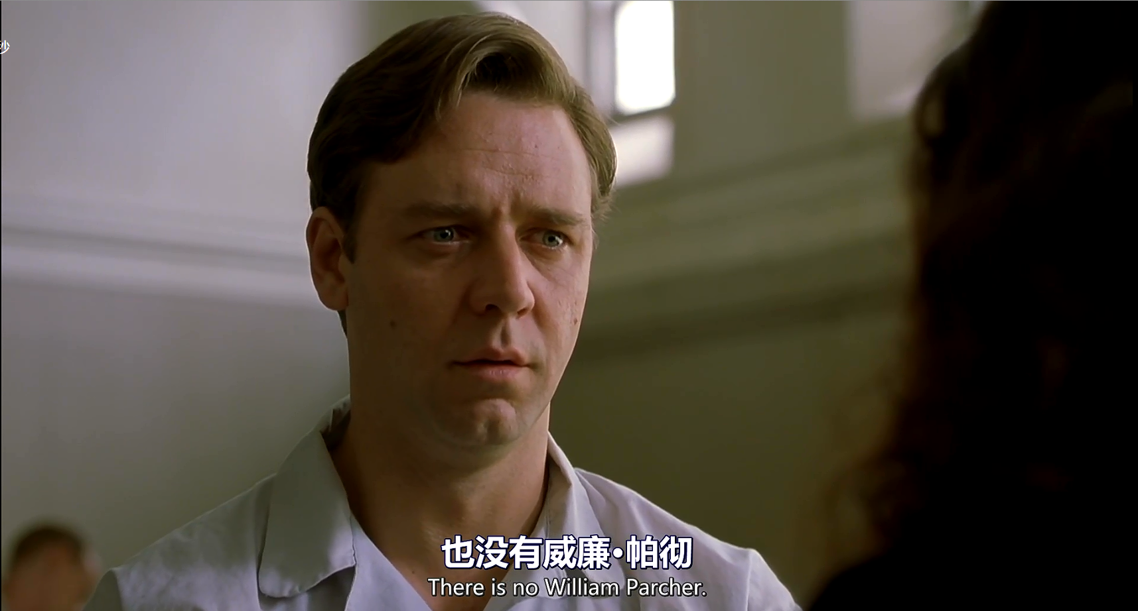
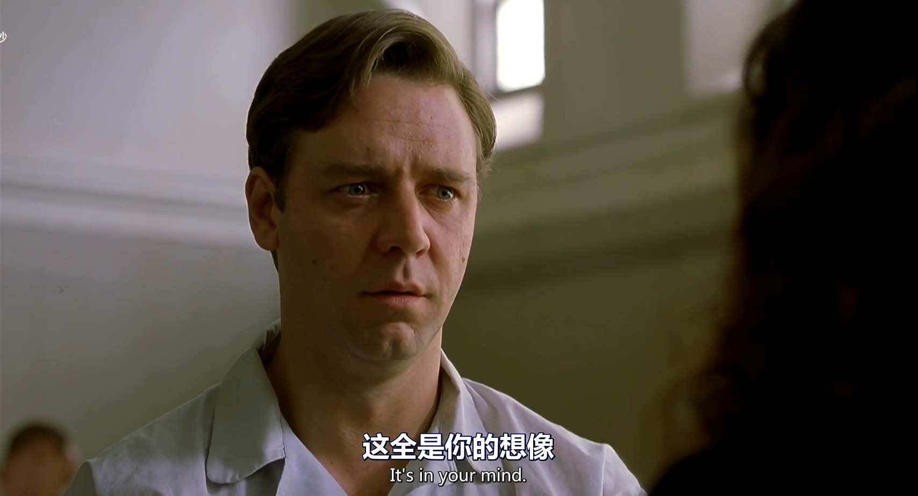
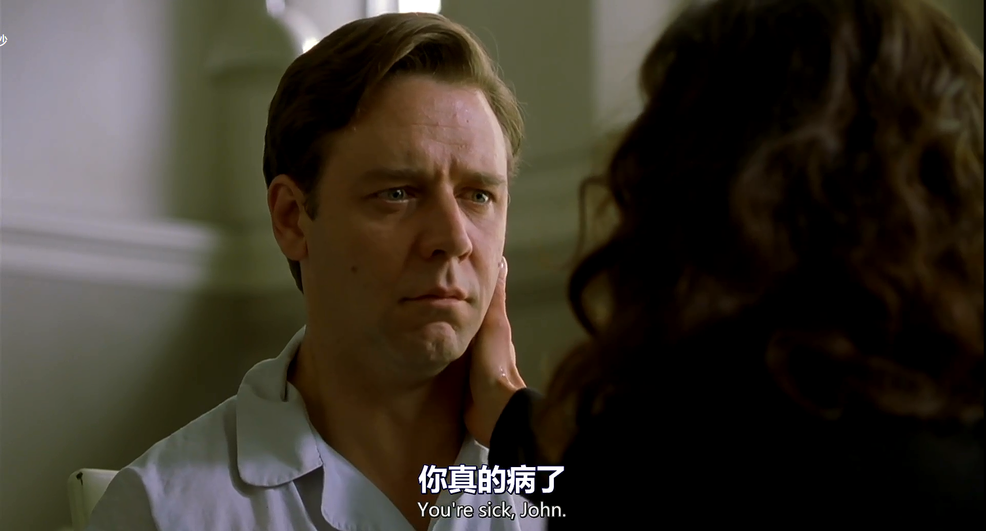
The doctor called Rosen found John and took him to the hospital for treatment.
Rosen told John’s wife that John had a mental disorder and he couldn’t tell what was real and what was illusion.
22121630 汪江豪

Slide 20
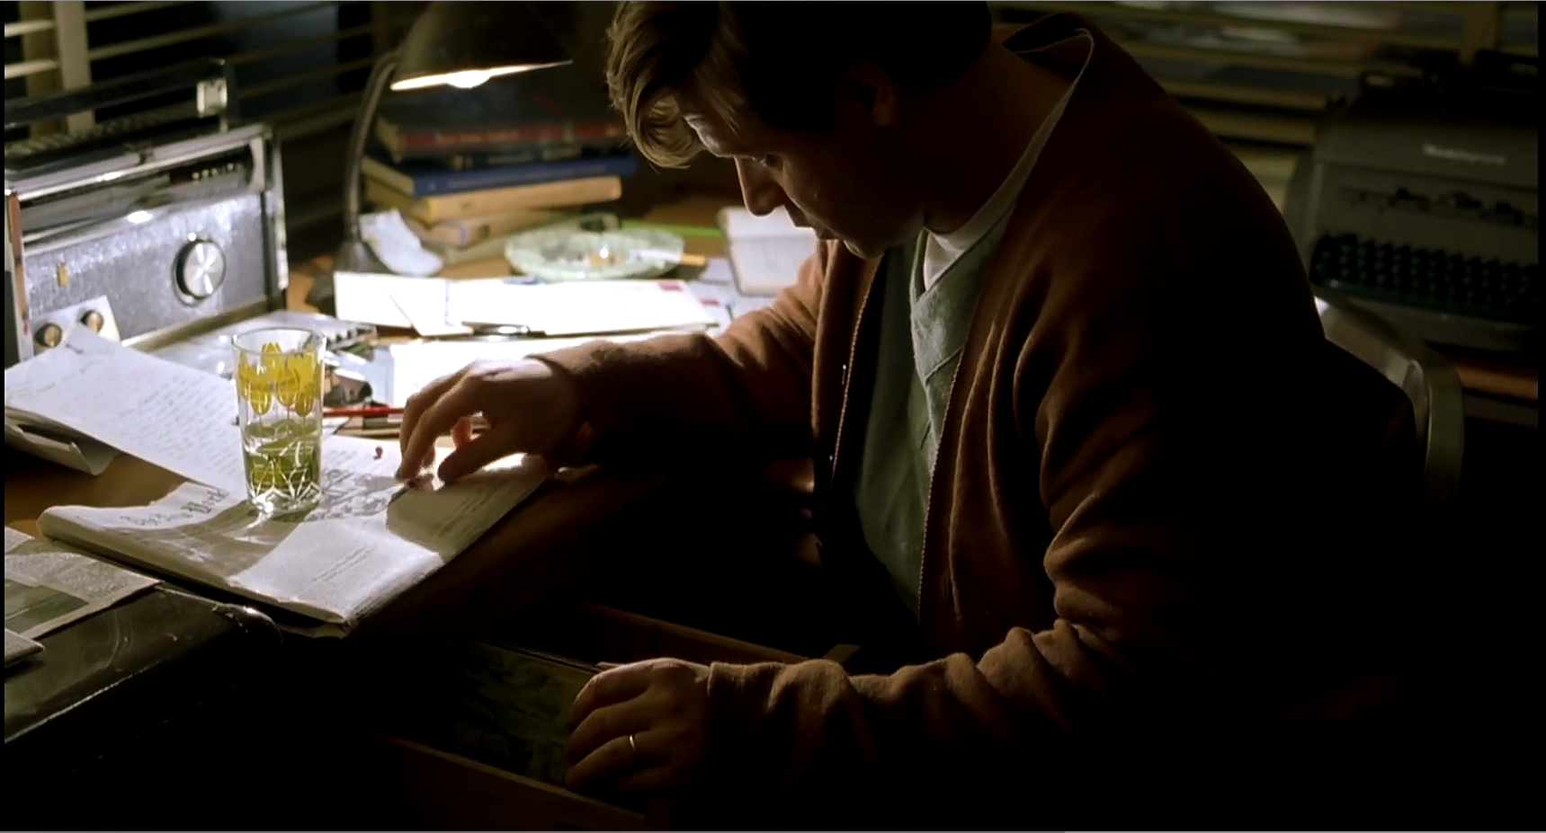
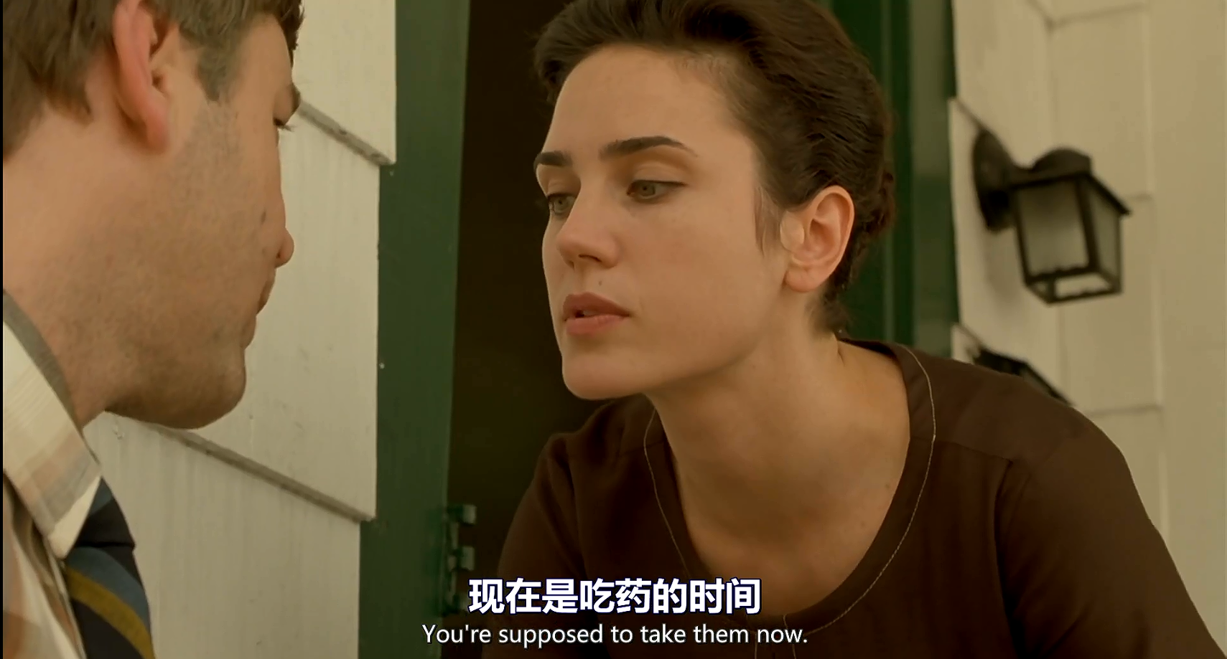
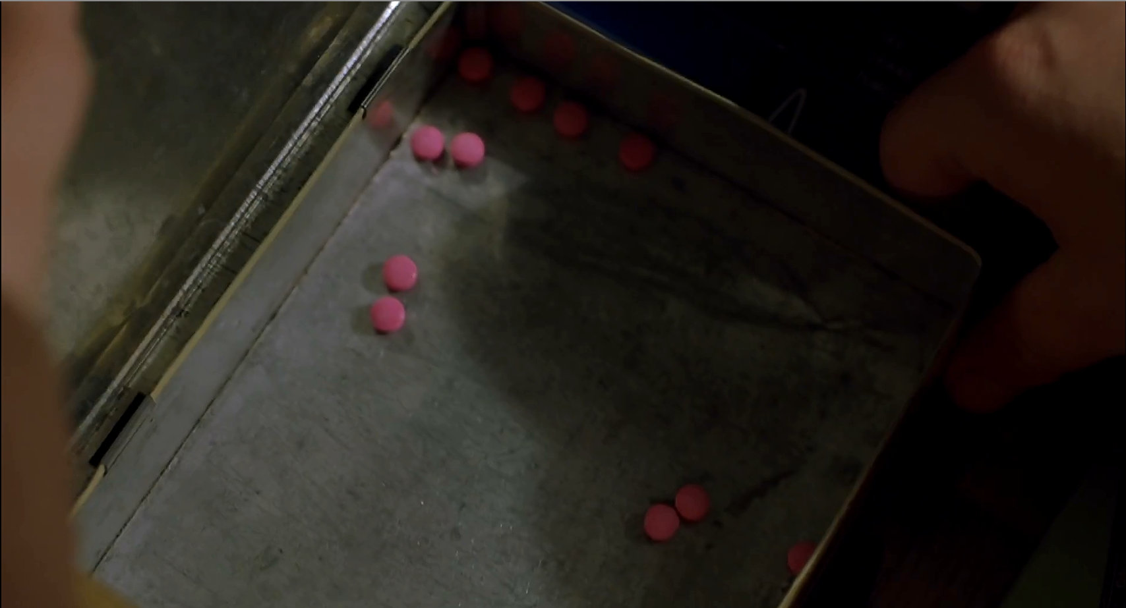
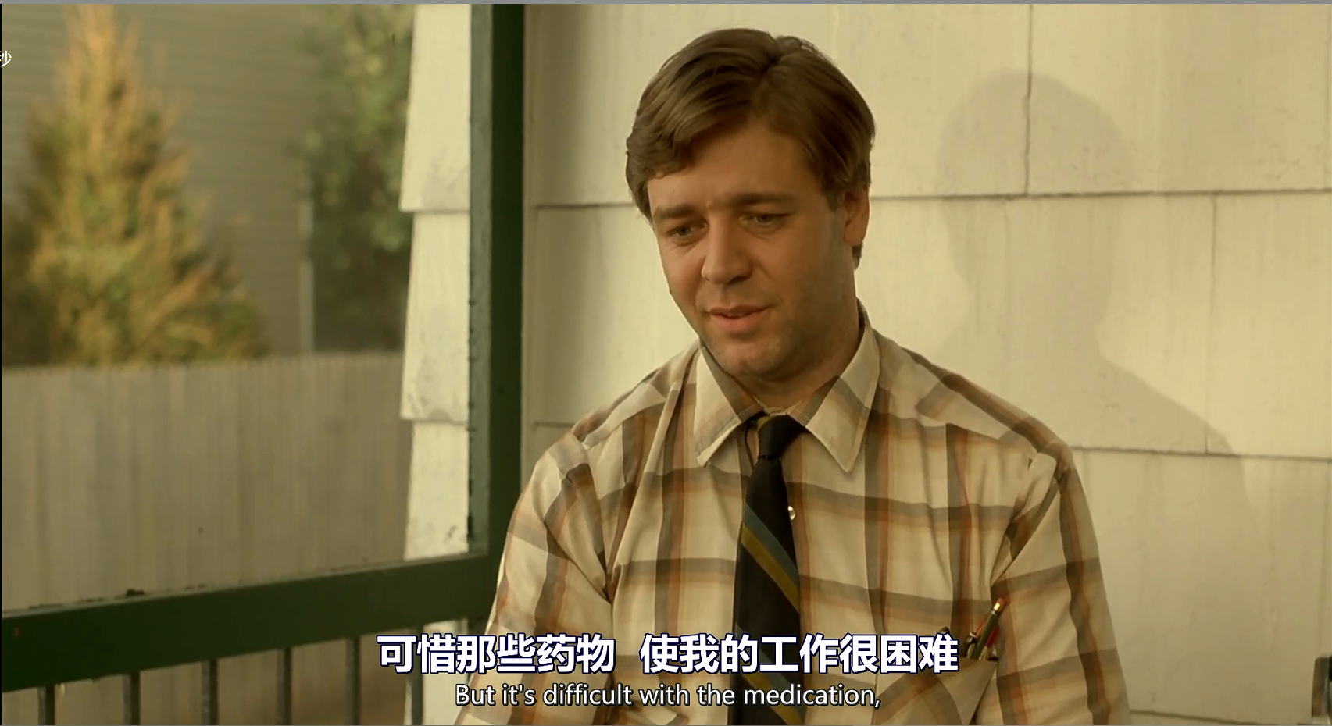
The doctor asked John to eat medicine, which dulled his mind. To sharpen his mind again, John stopped taking it.
22121630 汪江豪

Slide 21
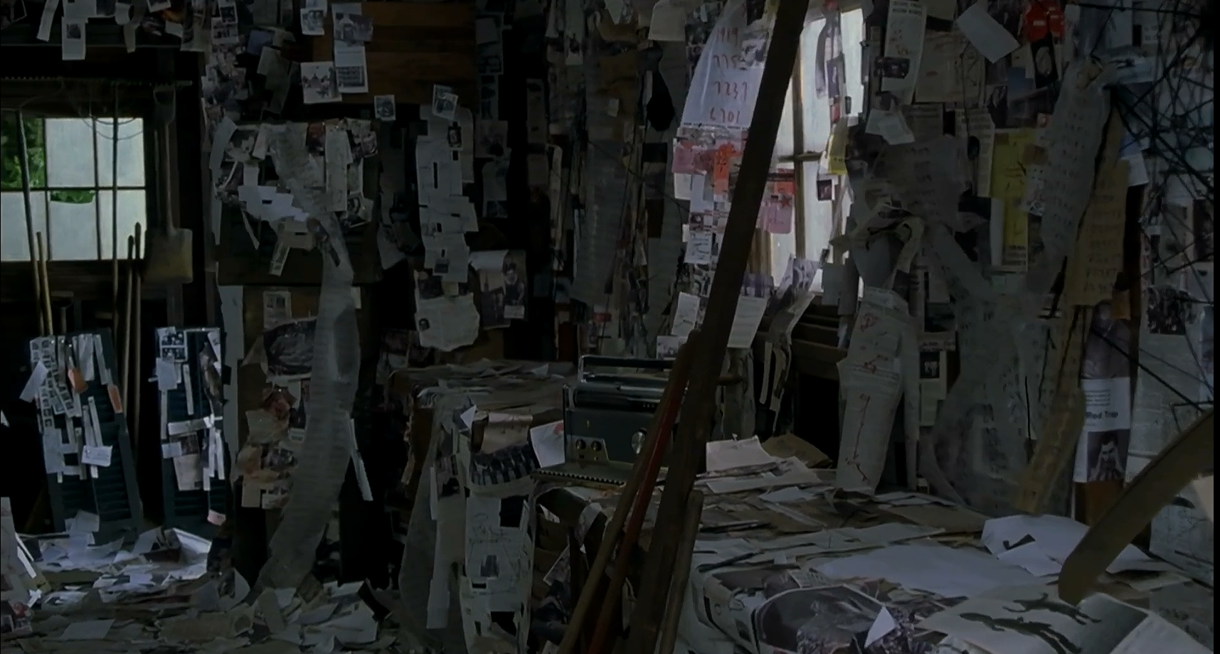
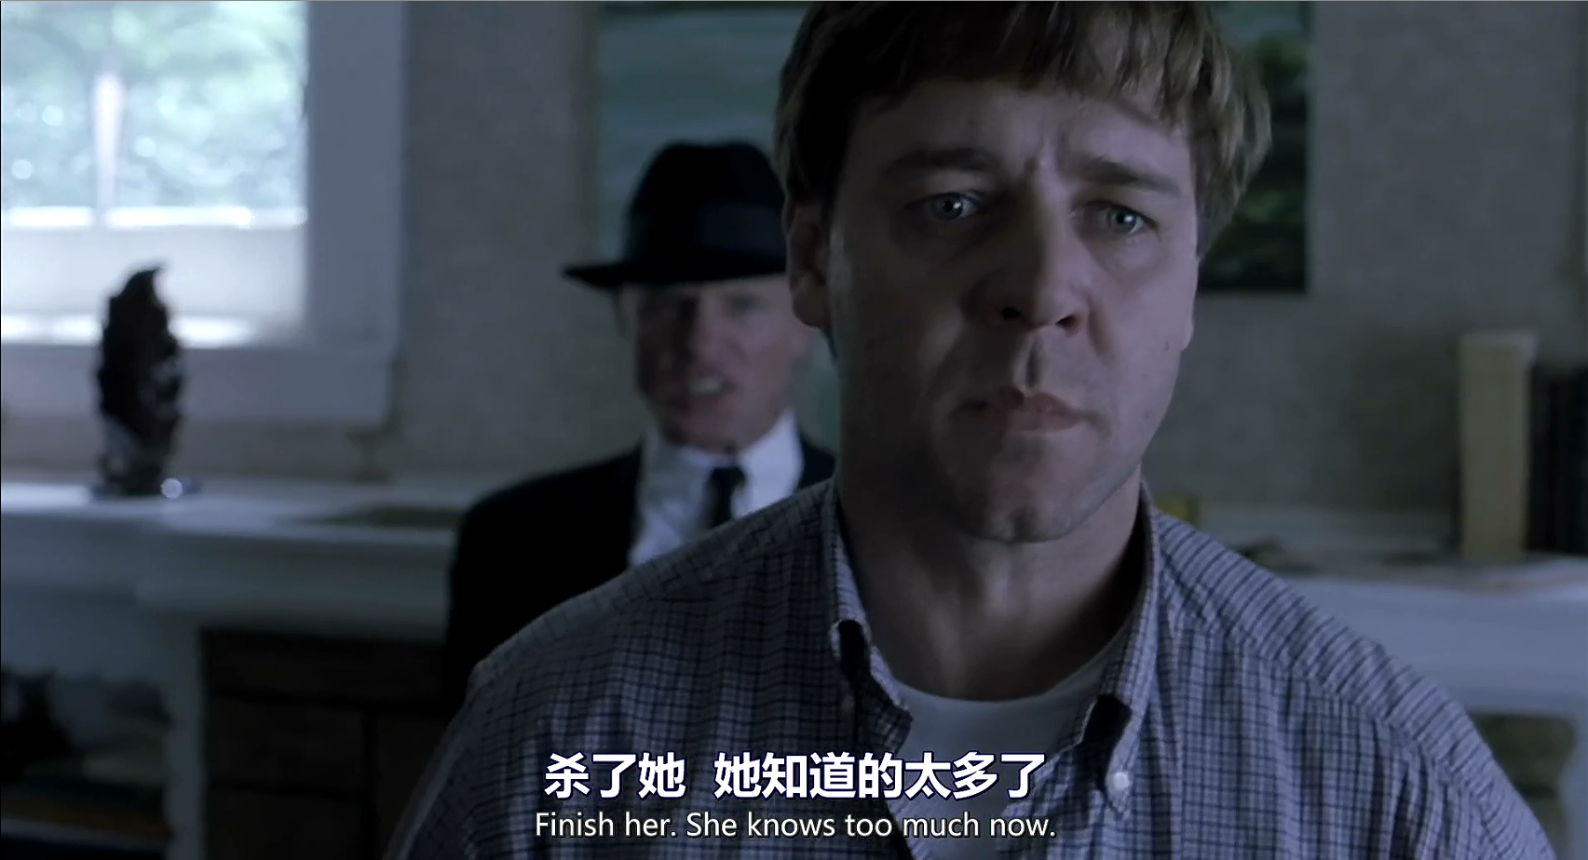


As a result, John’s delusions came back. In confusion, he scared his wife. Luckily, he distinguished reality and imaginary through his reason.
22121630 汪江豪

Slide 22
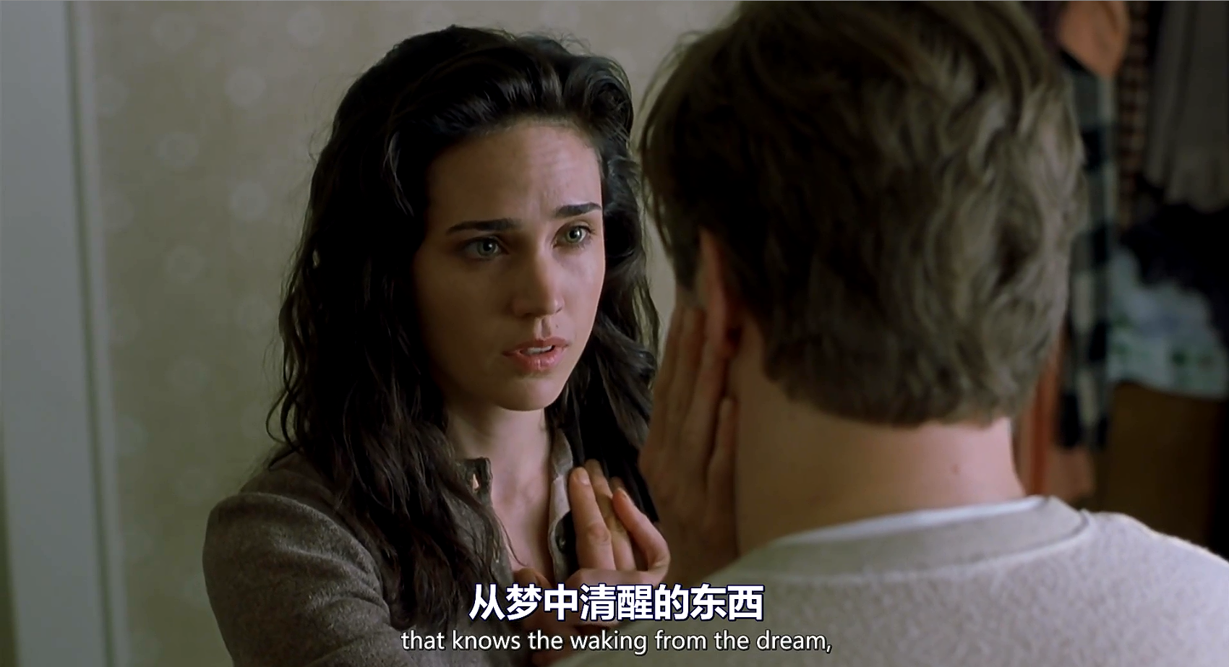
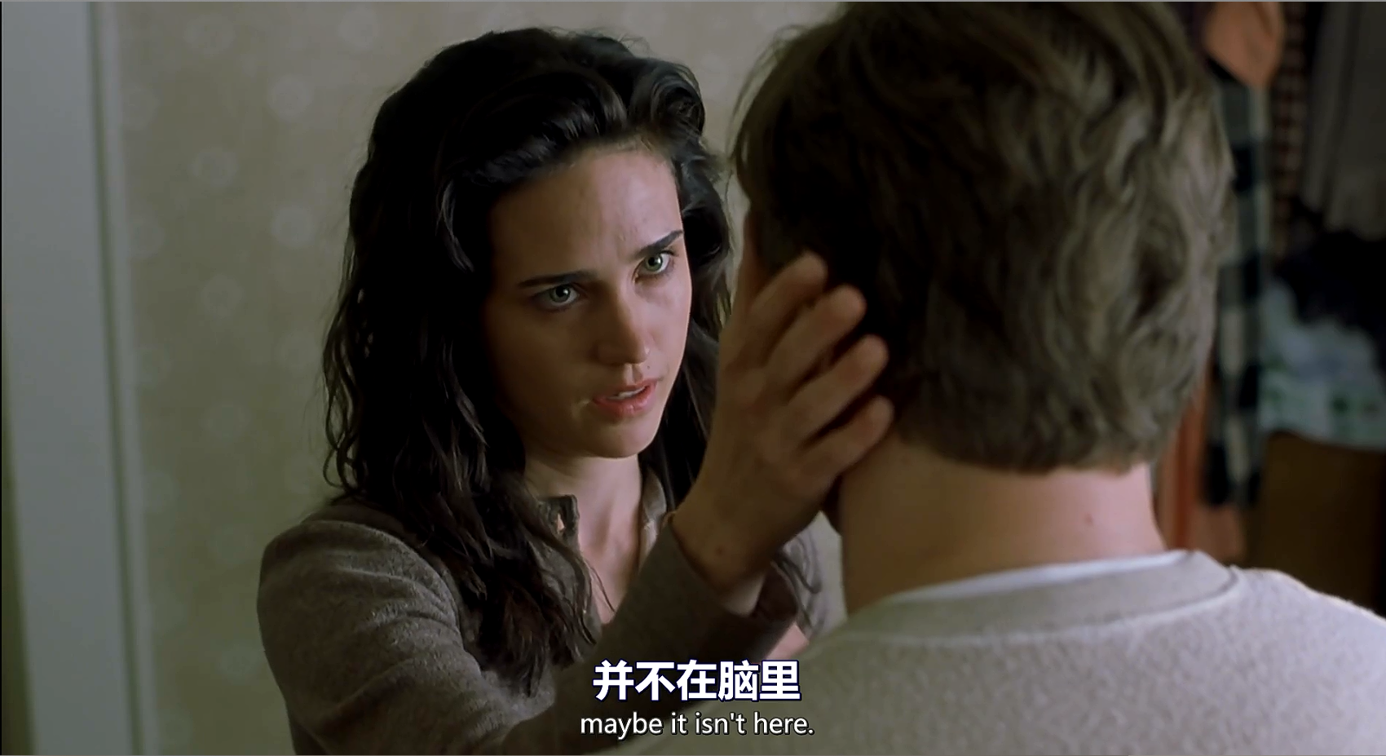

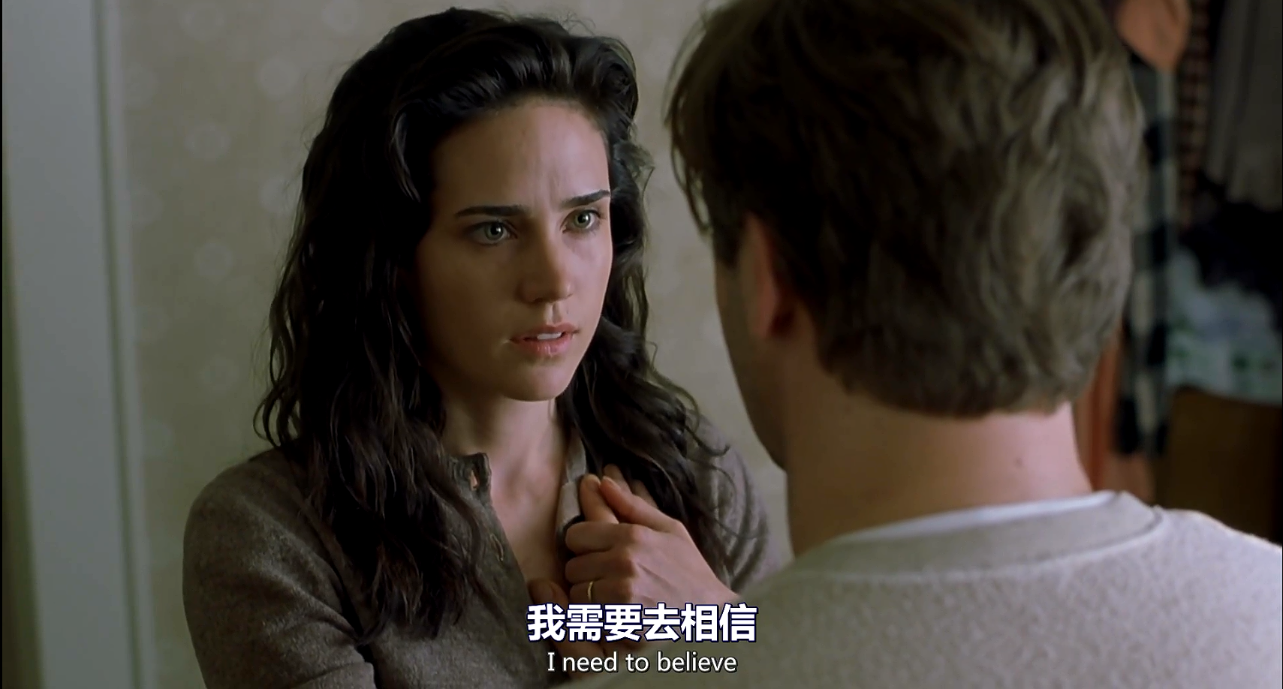
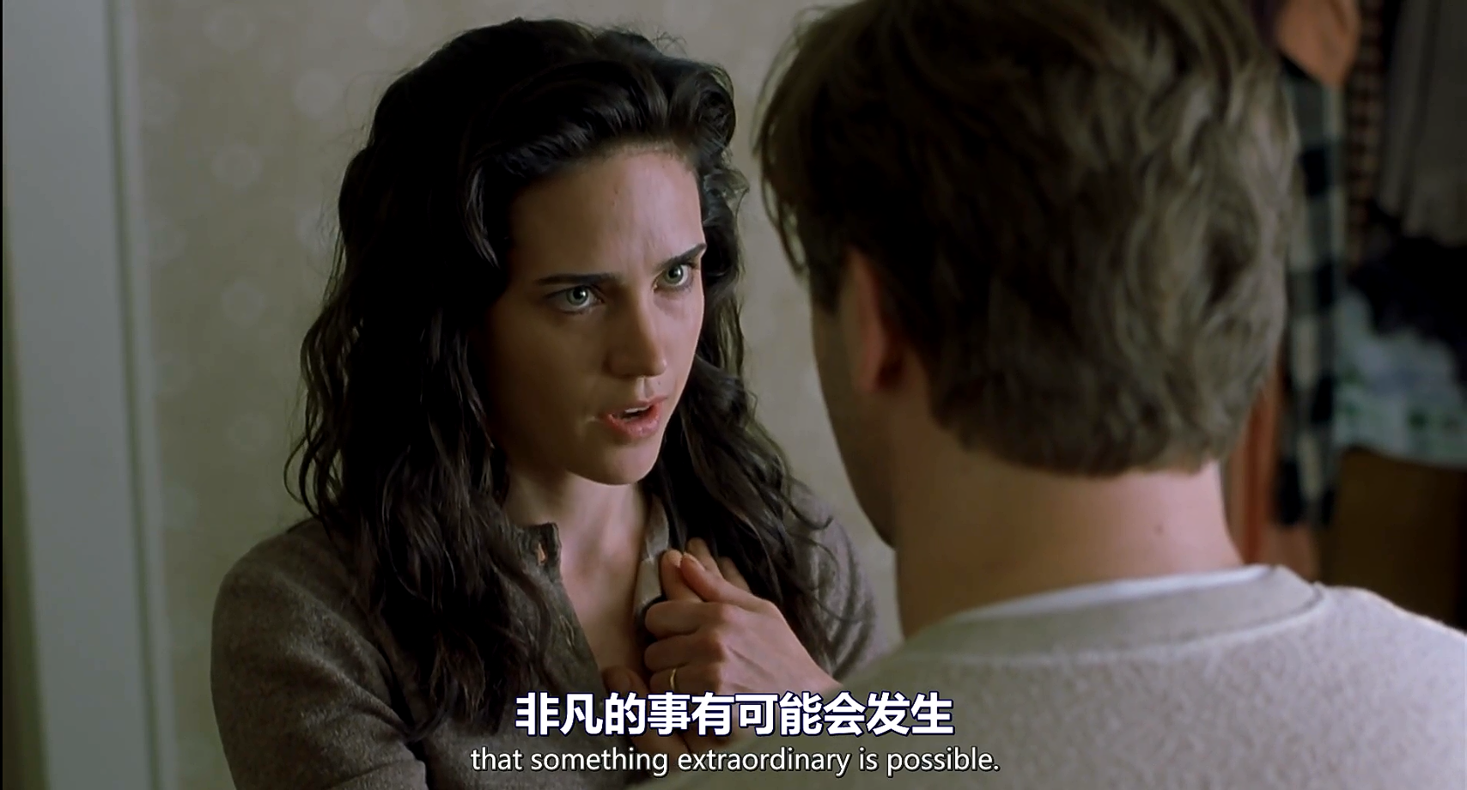
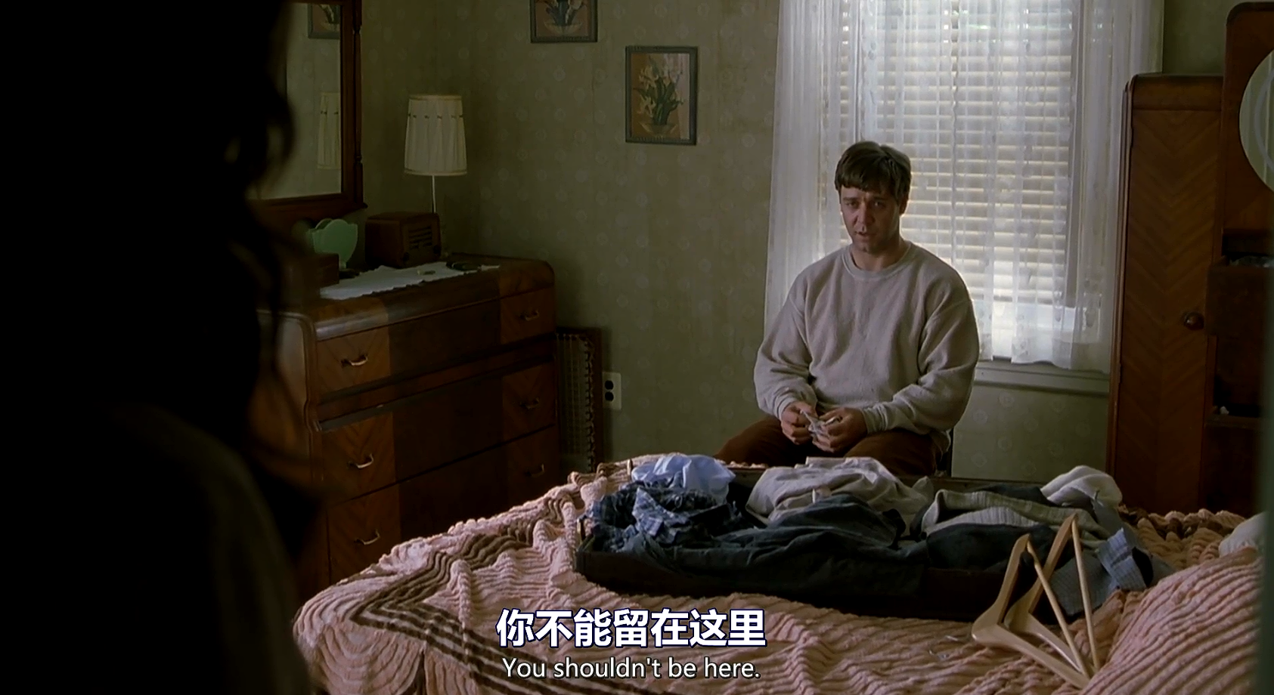
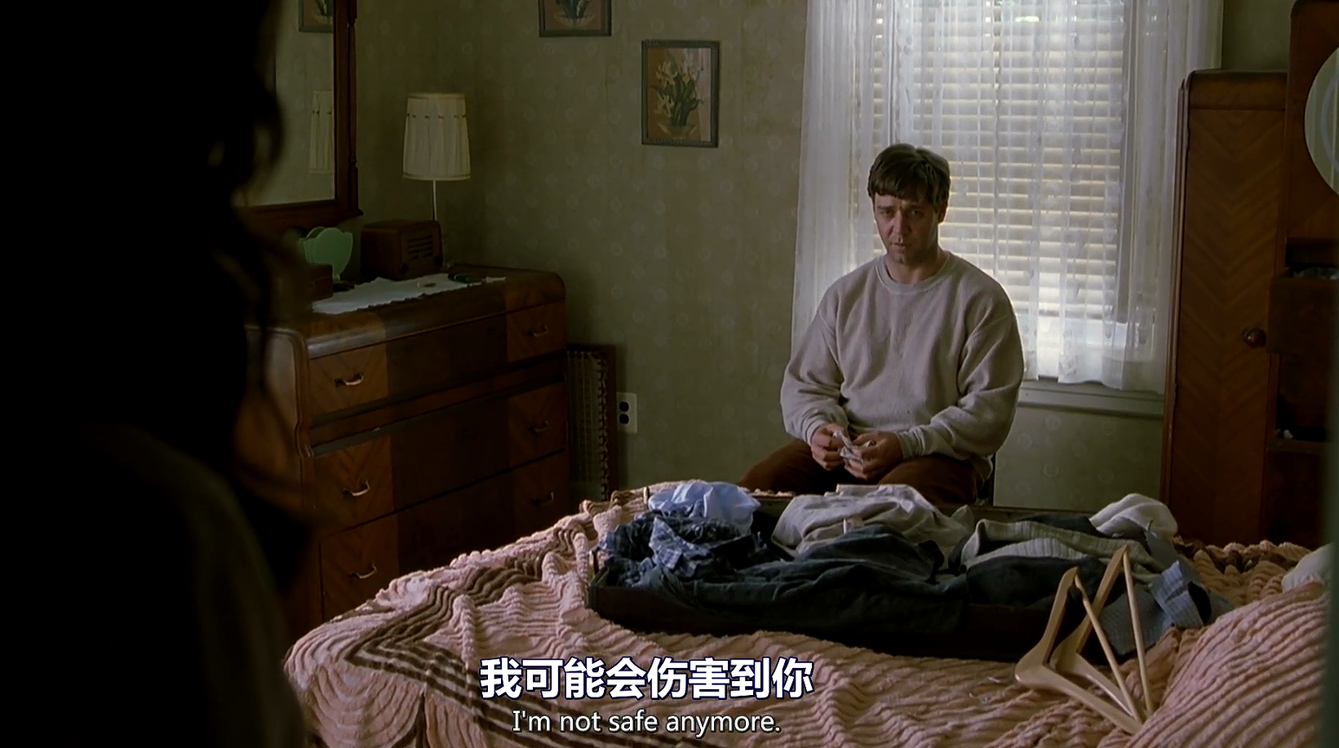
To avoid hurting his wife again, John advised Alicia to leave him. But his wife chose to stay with him and got him through with heart and love.
22121630 汪江豪

Slide 23
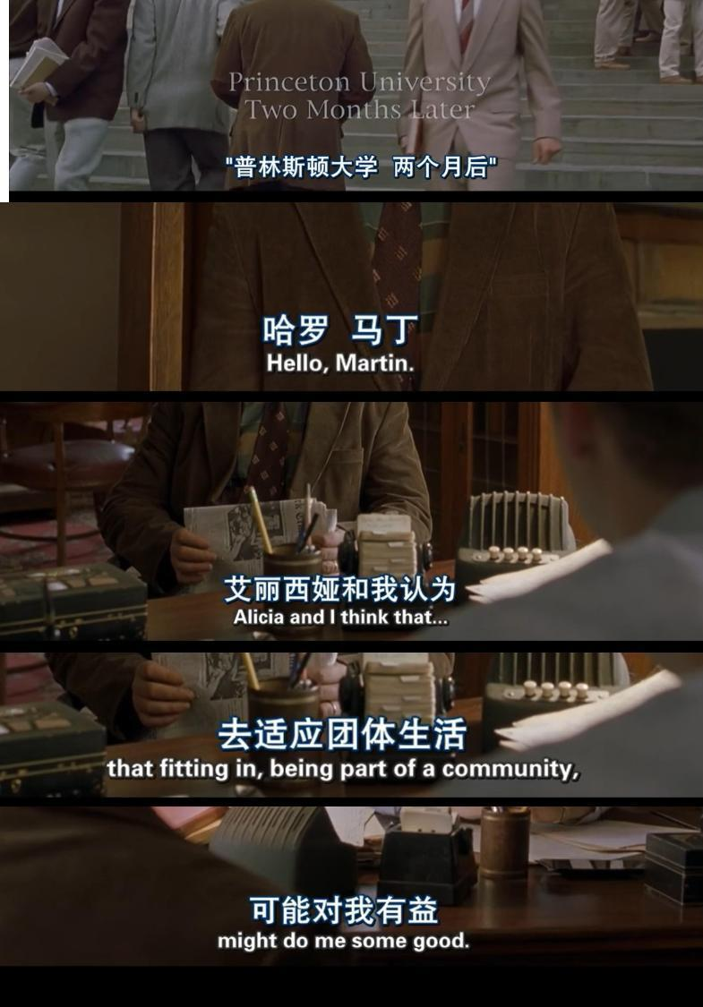
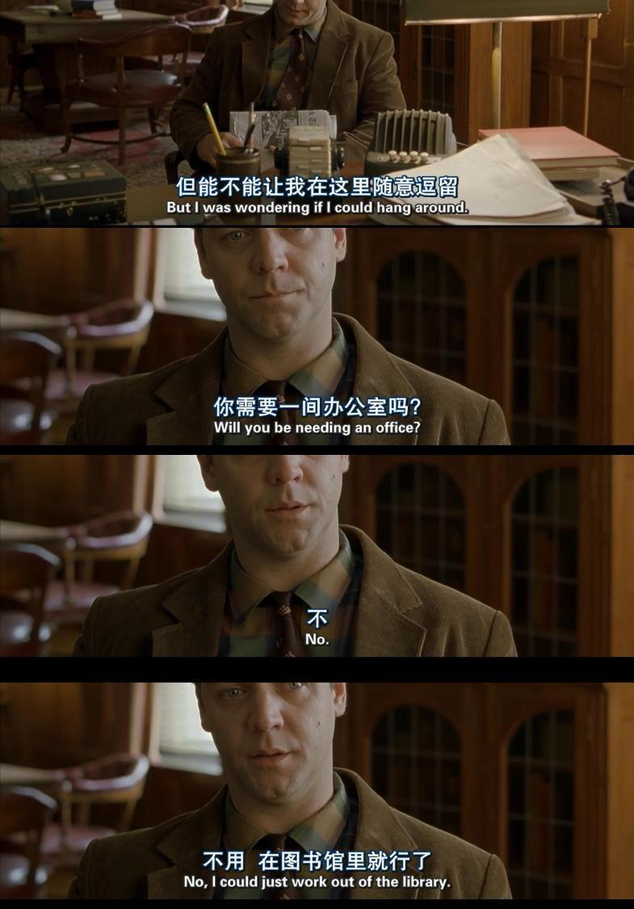
Two months later, realizing that fitting in a community might do some good to himself, John came back to Princeton
2212756 王子昊

Slide 24
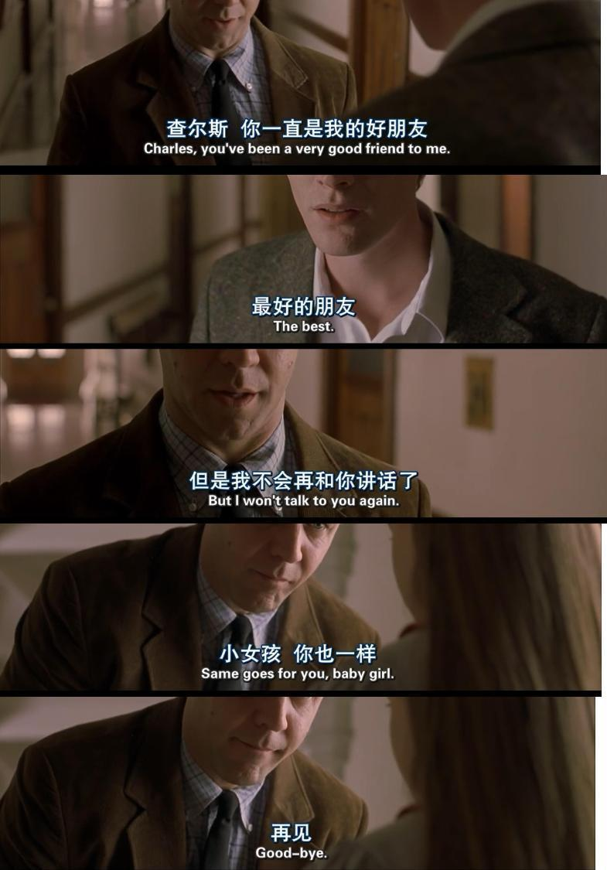
Although delusions still existed, John got used to ignoring them. And he resumed his teaching job.
22122756 王子昊

Slide 25
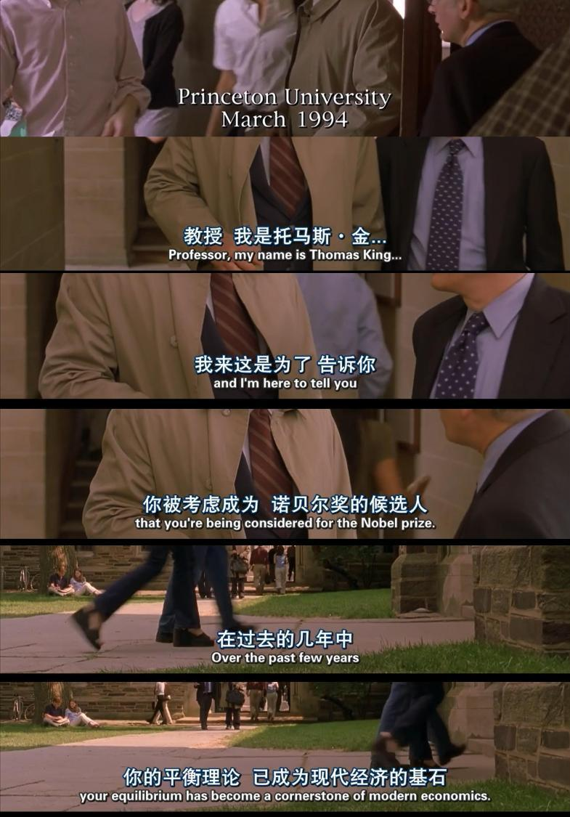
One day in March 1994, an old man called Thomas King found Professor Nash and told him that he was being considered for the Nobel prize because his original theories had become a cornerstone of modern economics.
22122756 王子昊

Slide 26
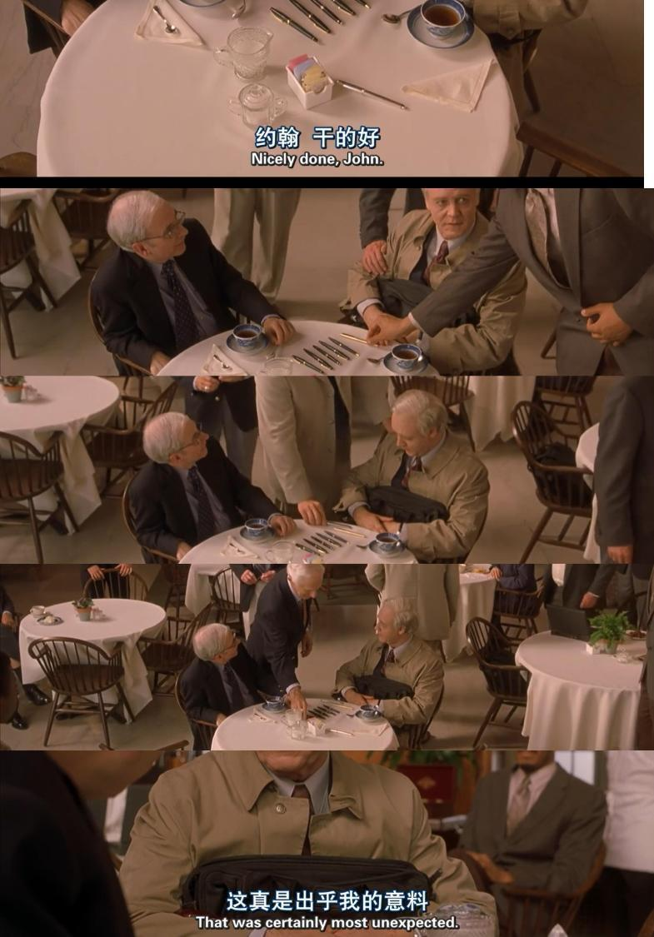
Thomas led John into the hall of fame. Many professors came and gift pens to show their congratulations and respects to John
22122756 王子昊

Slide 27
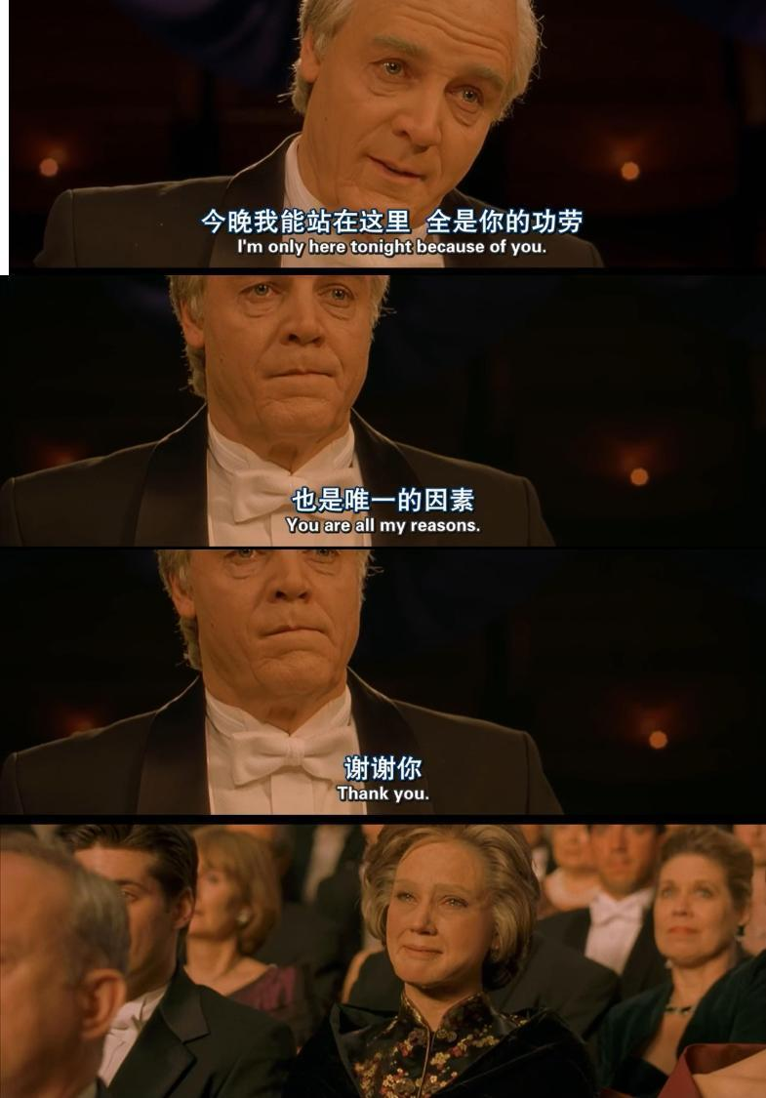
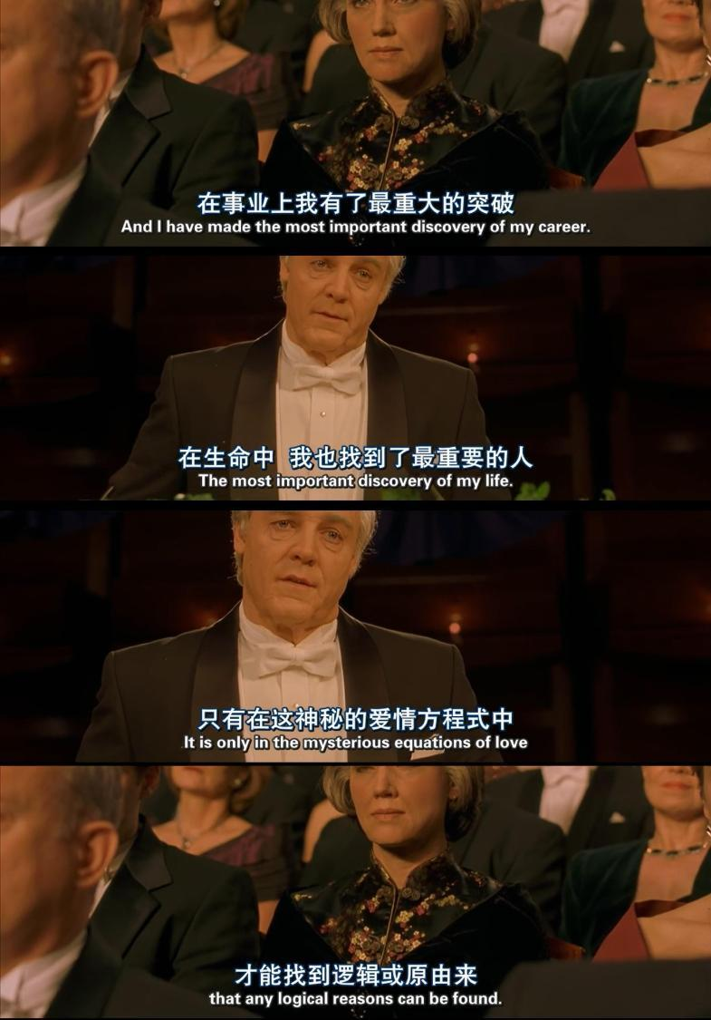
In December, at Nobel Prize Ceremony, John stepped on the stage, gave an acceptance speech, especially thanking his wife for her years of care.
22122756 王子昊

Slide 28
Thank
You

